Slide 2
CONTENTS
FACE - AIFACE-MARS
ET-2000 ONE-WAY BRIDGE TRIPOD TURNSTILE

Slide 3
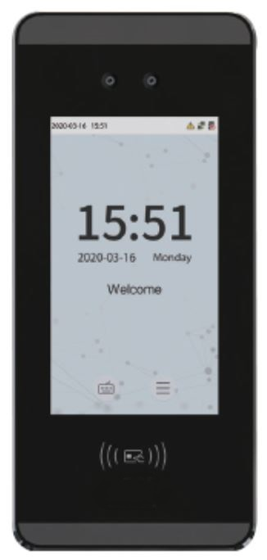
FACE - AIFACE-MARS
FEATURES :-
1). Visible Light Facial Recognition, Anti-spoofing algorithm against print attack(laser, color and B/W photos),videos attack and 3D mask attack.
2).Multiple Verification: Face / Card / Password.
3).Multiple card modules:125KHz ID card(EM) / 13.56MHz IC card (MF), 3000 face templates capacity

Slide 4
SPECIFICATIONS
Display : 5inch Touch Screen
Face Capacity 3000
Card Capacity 3000
Transactions 150000
Operation System Linux
Standard Functions ID Card, ADMS, T9 Input, DST, Camera, 9-digit User ID, Access Levels, Groups, Holidays, Anti-pass back, Record Query, Tamper Switch Alarm, Multiple Verification Methods

Slide 5
SPECIFICATIONS
Hardware 900MHZ Dual Core CPU Memory 512MB RAM / 8G ROM 2MP WDR Low Light Camera Adjustable Light Brightness LED
Communication : TCP/IP, WiFi(Optional), Wiegand Input/Output, RS485
Access Control Interface : 3rd-party Electric Lock, Door Sensor, Exit Button, Alarm Output
Optional Functions 13.56MHz IC Card / WiFi
Face Recognition Speed _1s
Biometrics Algorithms Face VX5.8
Power Supply 12V 3A

Slide 6
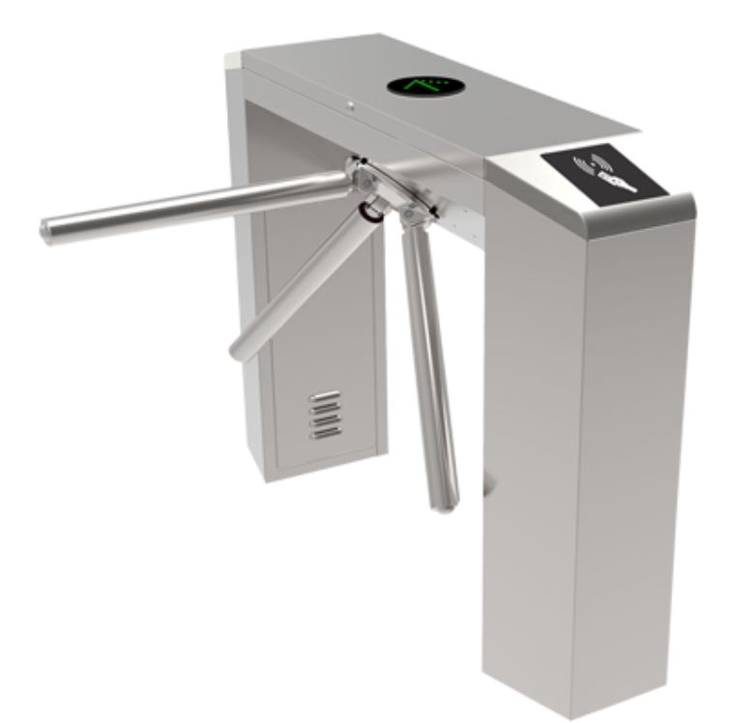
ONE-WAY BRIDGE TRIPOD TURNSTILE
FEATURES:-
1).Passage width : 550mm
2).T2hroughput rate : 35 p/m
3).Max tolerance of Arms : 80 Kg
4).Angle per rotation : 120°

Slide 7
SPECIFICATIONS
Passage width : 550mm
Throughput rate : 35 p/m
Power supply : 100 ~ 240V
Operational voltage : 24V
Max tolerance of Arms : 80 Kg
Angle per rotation : 120 °
Operation Type : One-way - Bidirectional
Input control signal : Dry contact

Slide 8
Specifications
Max Power Consumption : 30 W
Frequency : 50 ~ 60hz
Protection level : IP44
Working temperature : -25°C ~ +70°C
Electro - magnetic drive : DC
Dimension Excluding Bar : 1200x280x980 mm
Net weight including bar : 52kg
Opening Duration : 5s - 60s

Slide 9
Thank You
www.ampletrails.com

