Slide 1
Guard Monitoring Platform
By Fortuna Impex
Marketed by AmpleTrails

Slide 2
Overview
This solution will provide you with detailed insight into the field operations of their Guards and Supervisors.
Value to our clients will be further increased by an automated individual security guard performance score card at the end of each month.
This may be the basis of Payment to Guard Tour Monitoring Company.

Slide 3
Features for SAMSUNG
Key Features
Dashboard
Multiple Site Creation
Guard Master data
Allocate Guards to sites
Create Multiple check points at each sites
QR Code type
NFC Type
GPS Type
Create Patrol Routes with Single or multiple Check Points
Assign Guards to Patrol Route
Real-Time alerts Dashboard
Shift start alert
Guard inactive alert
Shift completion alert
SOS alert
Analytical Dashboard
Reports
Timesheet
Guard Performance
Monthly Patrol

Slide 4
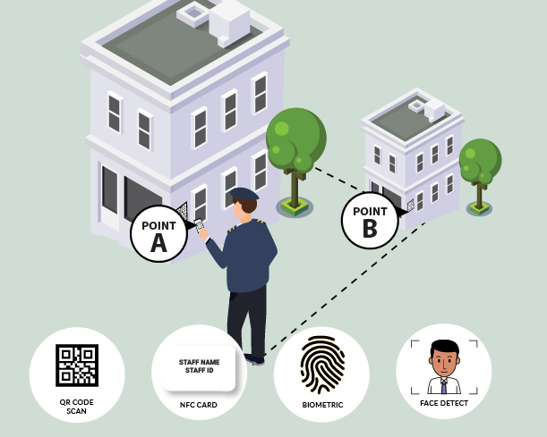
Schematic Representation of Guard Monitoring Platform

Slide 5
Features for Guard
Key Features
Dashboard for Guard
Face based realtime Attendance
Patrolling
Tracking QR/NFC/GPS
Face Tracking
Incident report
SOS
Real-Time alerts Dashboard
Shift start alert
Guard inactive alert
Shift completion alert
SOS alert
Analytical Dashboard
Reports
Timesheet
Guard Performance
Monthly Patrol

Slide 6
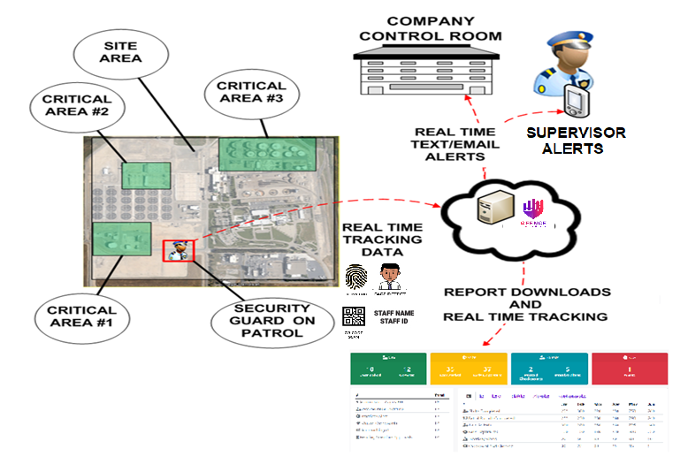
Real-time View

Slide 7
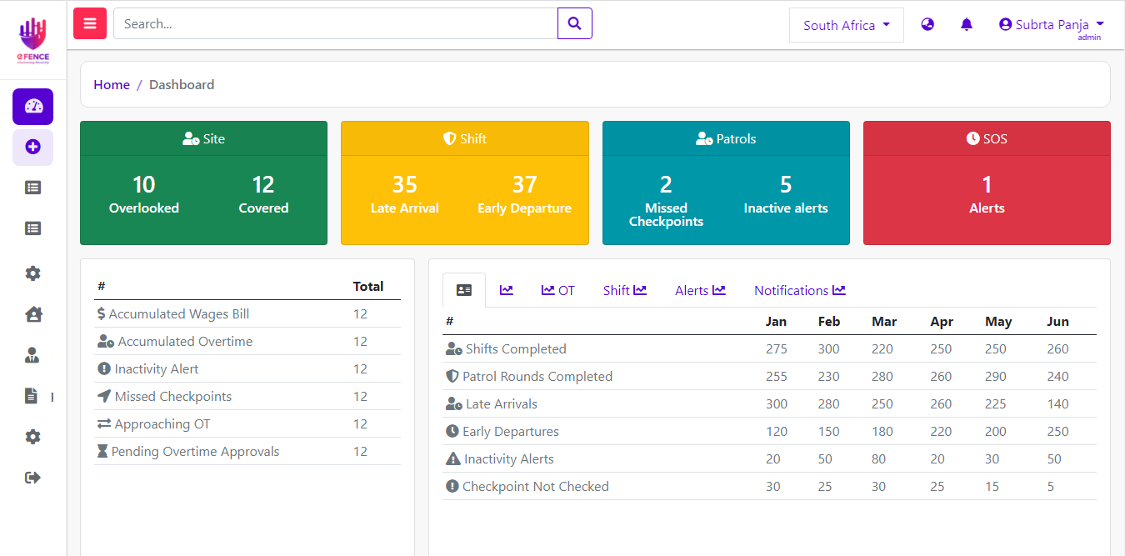
Admin Dashboard

Slide 8
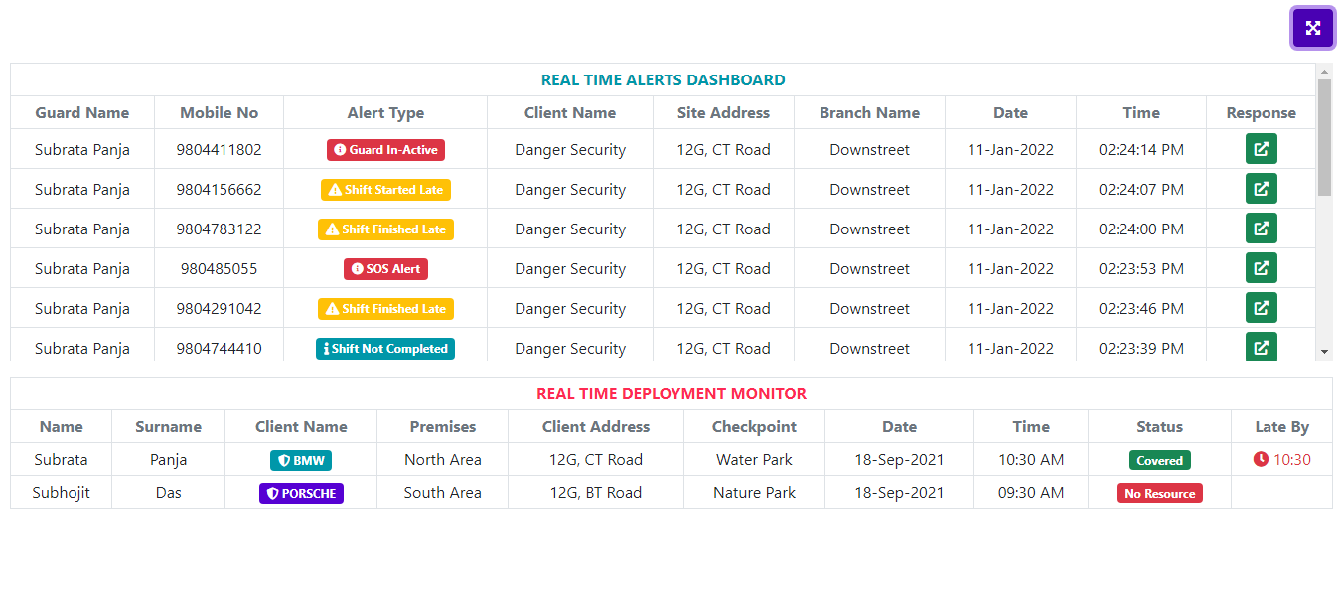
Real-time Dashboard

Slide 9
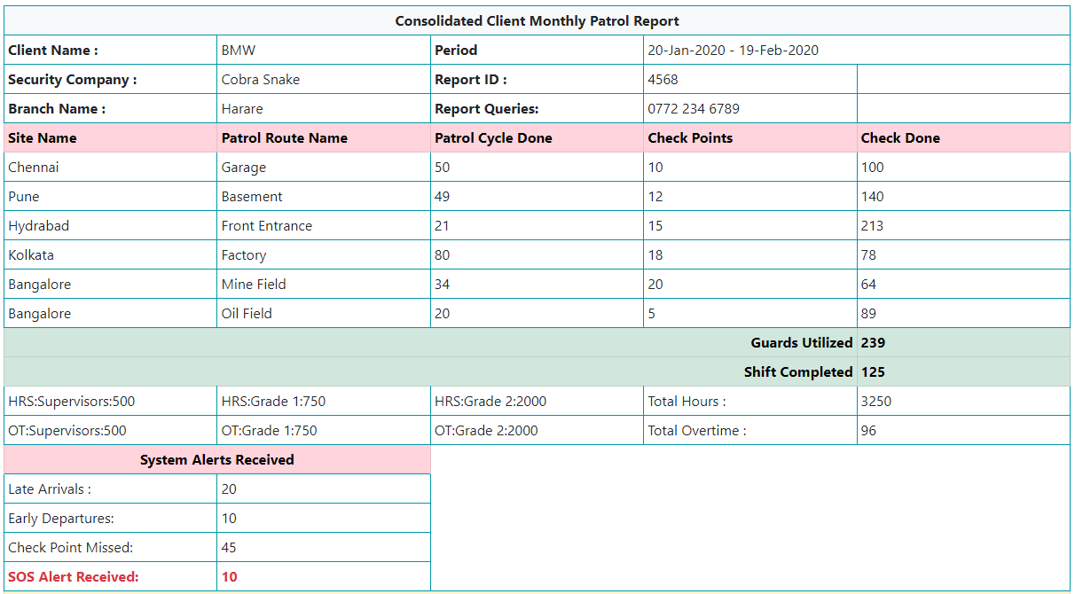
Monthly Patrol Report

Slide 10
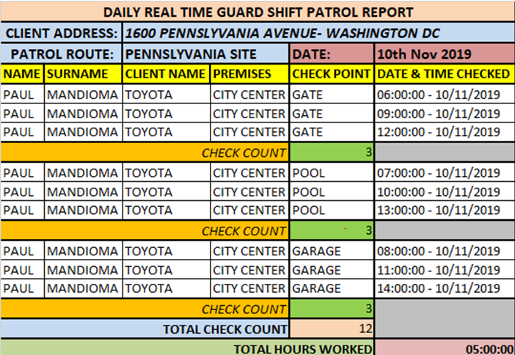
Real-time Patrol Report

Slide 11
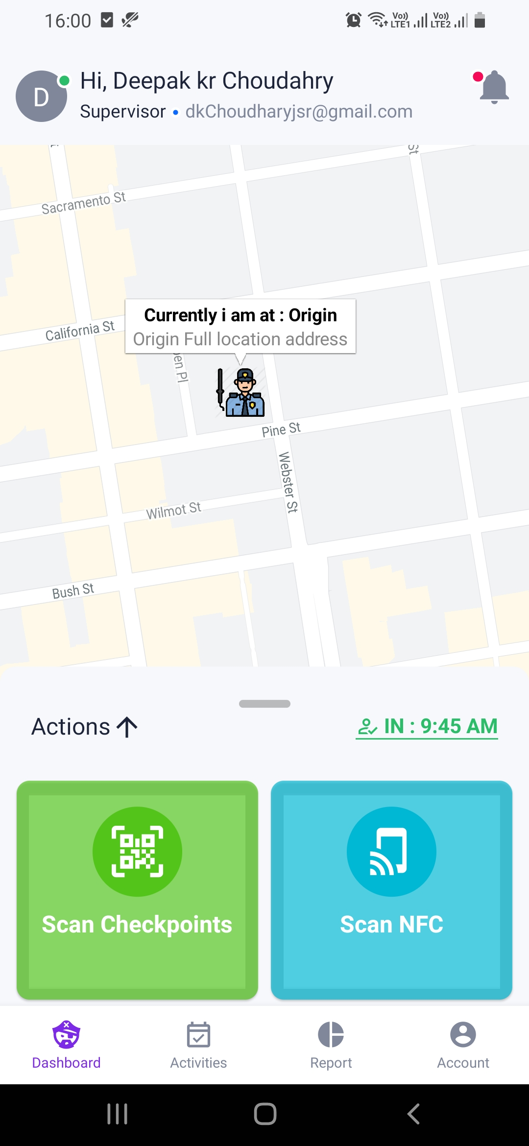
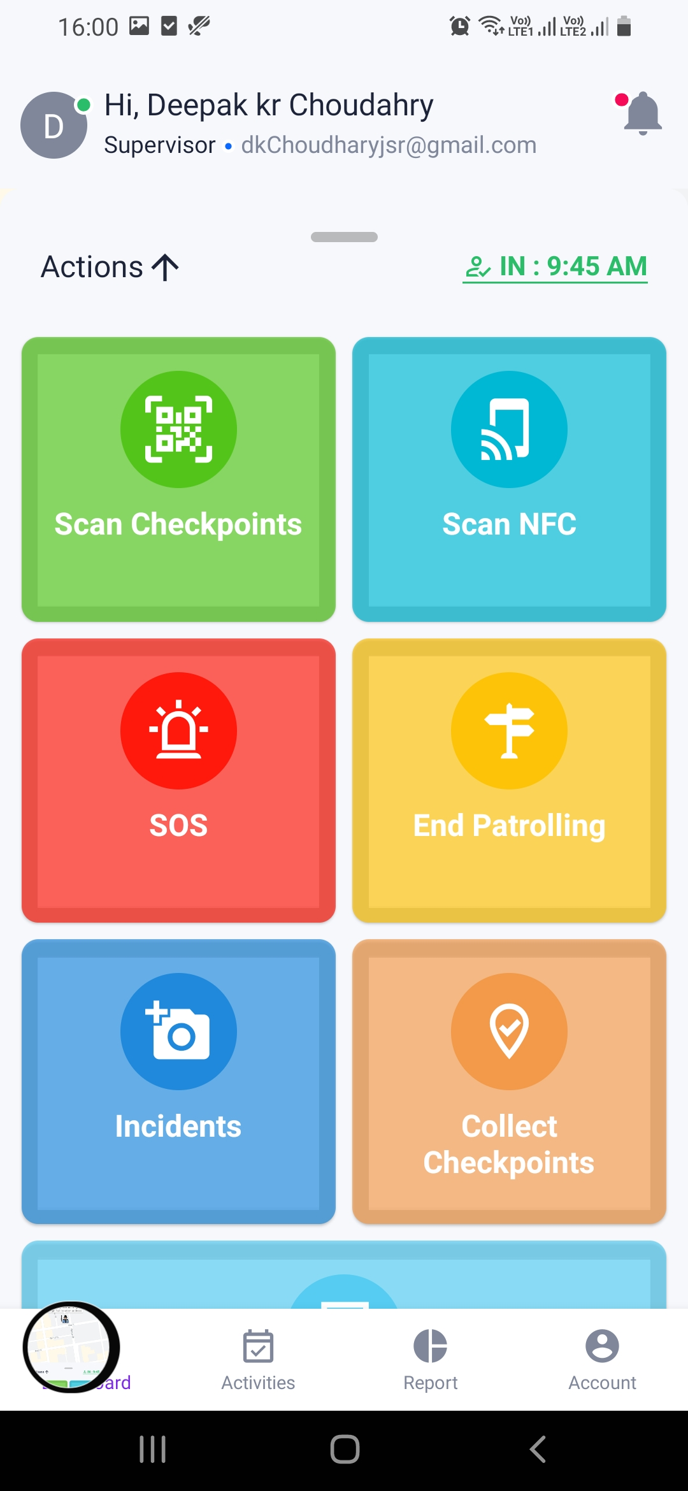
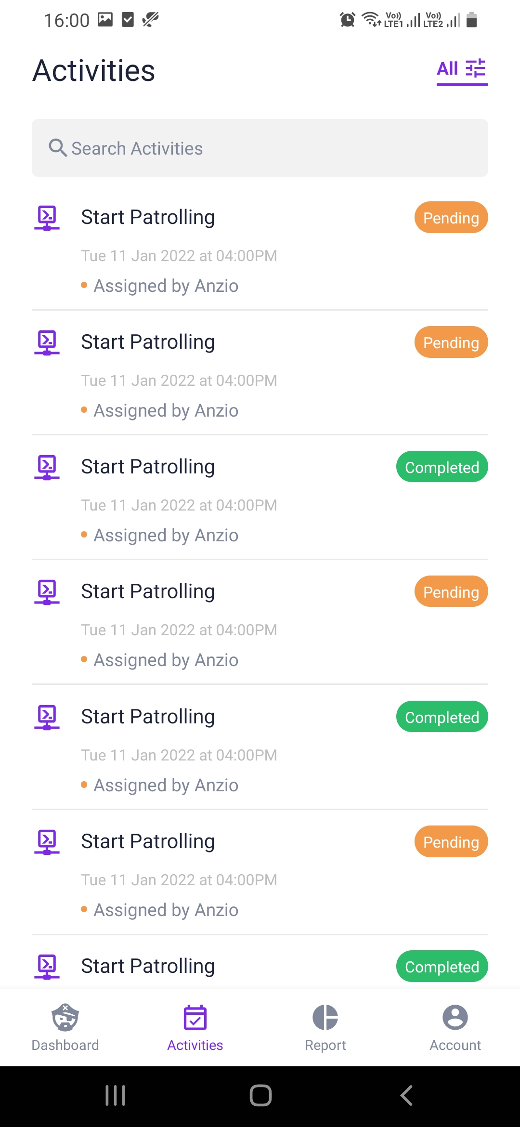
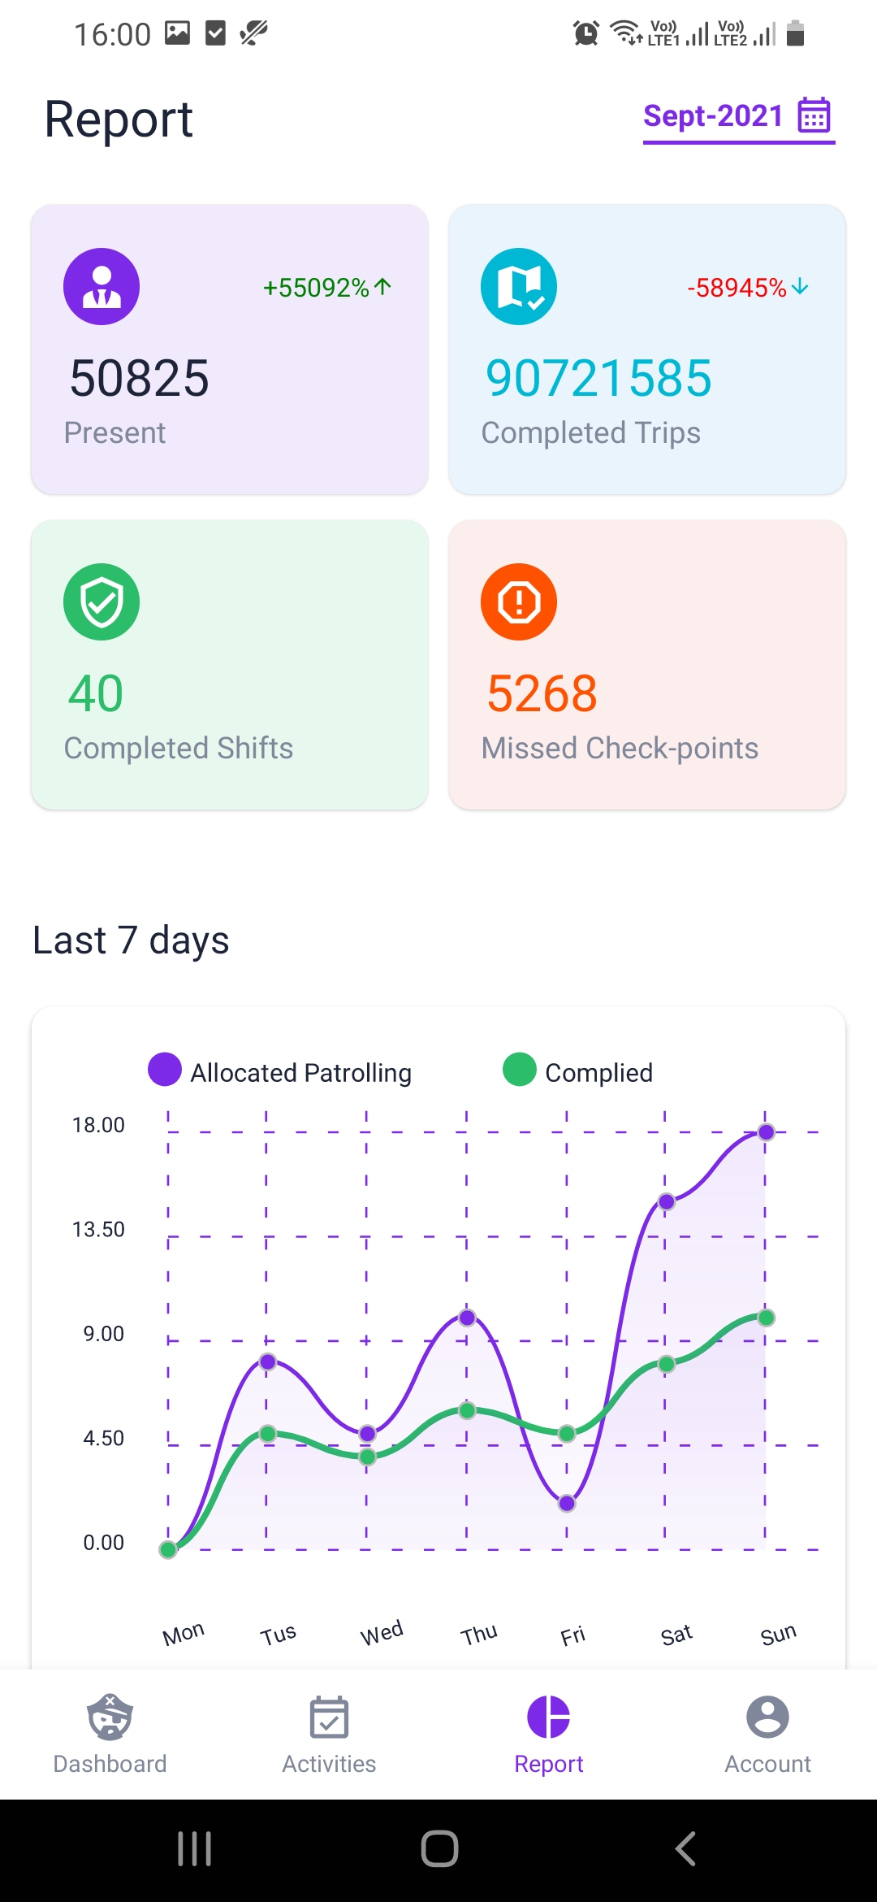
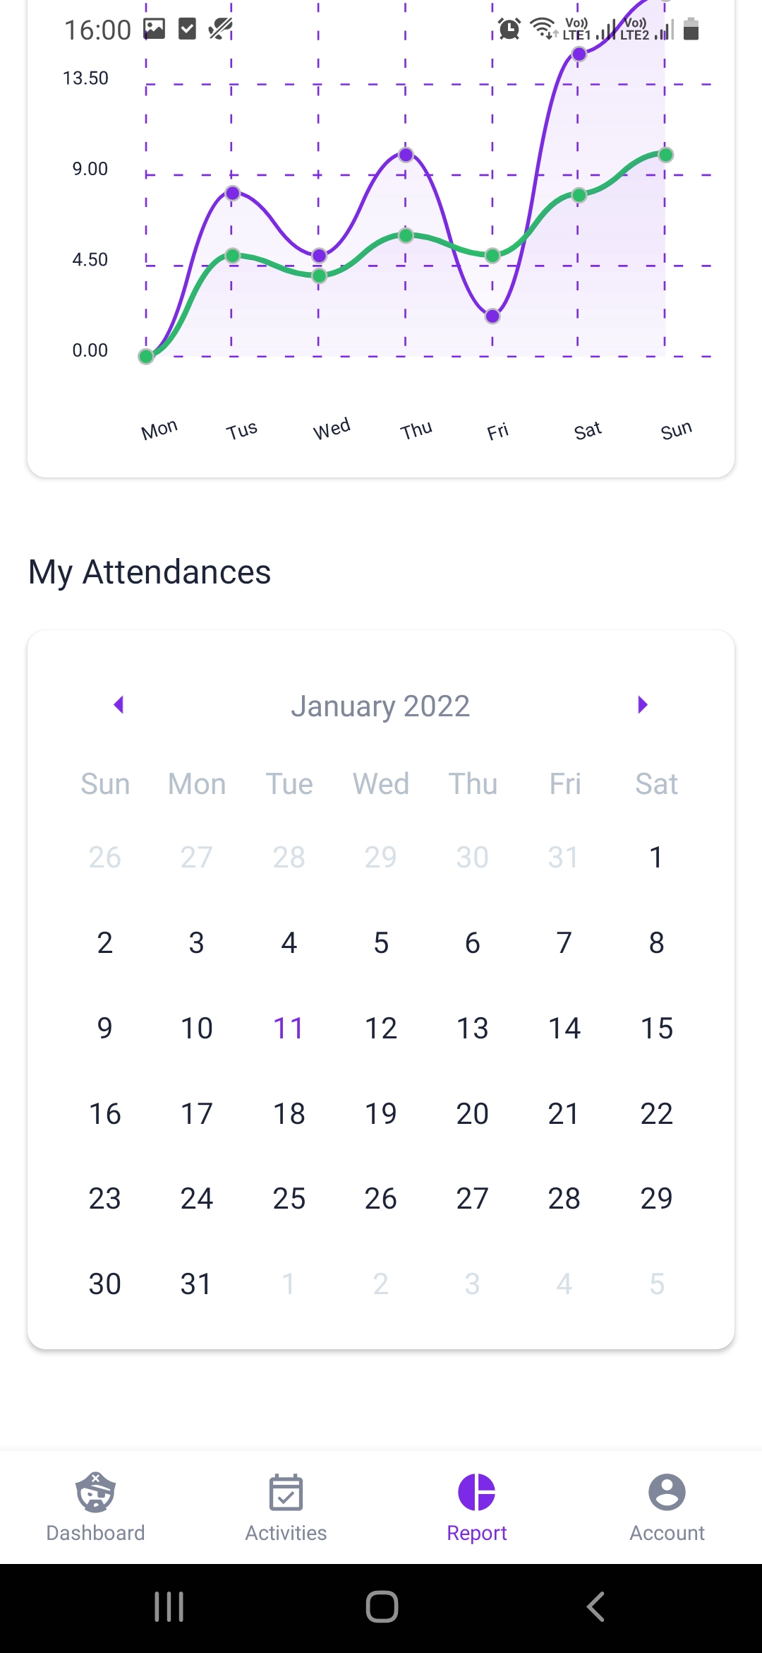
Mobile App Operation

Slide 12
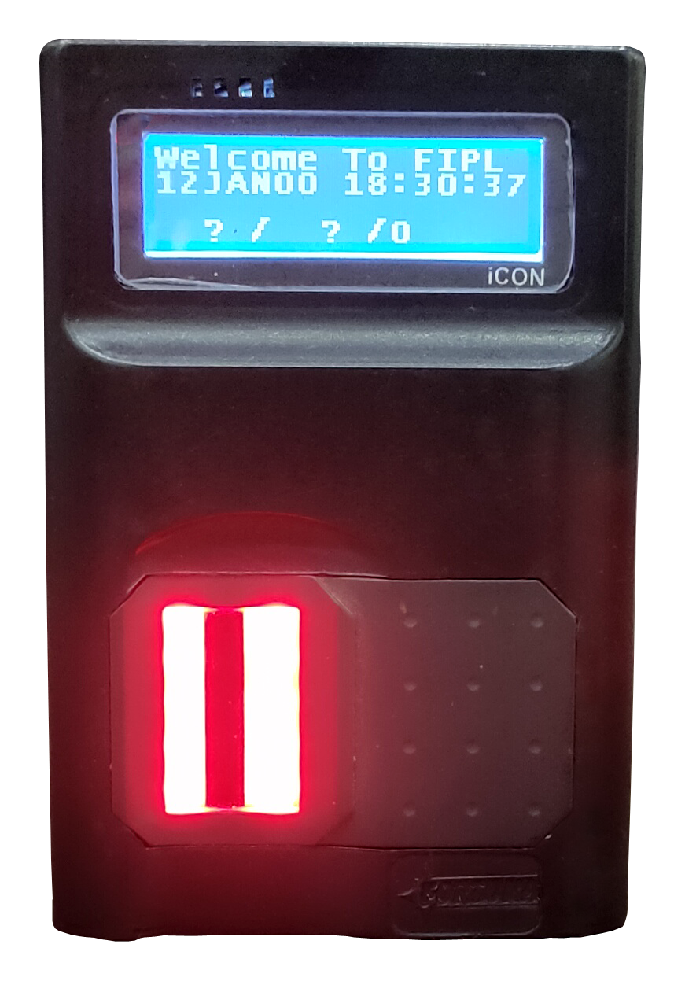
Pocket Size Biometric Attendance System & Guard Tour Patrolling System

Slide 13
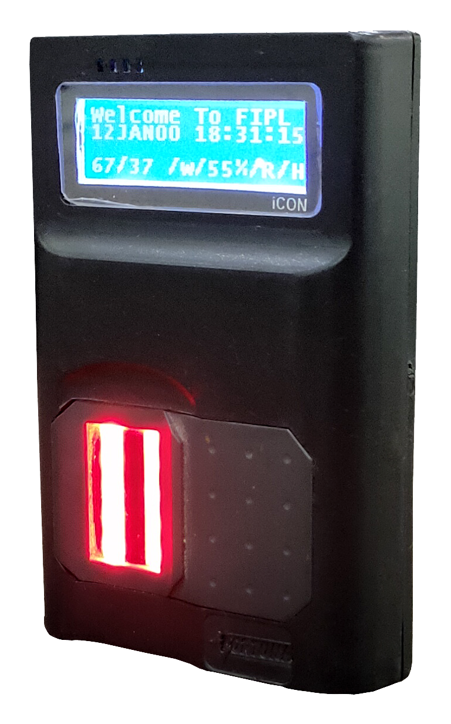
SPECIFICATION
High Speed CPU @ 240MHz
Morpho Biometric Sensor, with 500 User Capacity
WiFi & Bluetooth Interface
Battery back-up using Li-Ion Battery(1700 mAH) with upto 8 hours back-up in standby mode
USB Charging for Battery
Access Allowed/Denied LED
1.8” Graphic LCD with upto 4 line display
IoT based Device with Push Technology
Size :
A. Attendance System : 95(H) X 64(W) X 24(D)mm
B. Guard Tour Patrolling system : 95(H) X 64(W) X 28 (D)mm
Optional
Built-in GPS with Geo-fencing feature
Built-in GPRS(2G) with SIM Card Slot
Built-in RF/MiFARE card reader (Available in Guard Tour Patrolling System)

Slide 14
Guard Tour Patrolling System Function
Guard traversing Route may be defined with Friendly Name, on the system once
Upto 50 Check-points may be defined against the Route mapped to Card Number
Check-points may be named suitably, for identification & trip order

Slide 15
Guard Tour Monitoring System Work-flow
After scanning the 1st Check-point the device prompts for the Finger Verification
Registered Security Guard Finger will be identified & trip allocated to this guard
The LCD shows the Route Name with Next Check point Name to be covered
The Security Guard has to follow the Patrolling Route for Patrolling the check points on timeline
If any security Guard starts the new route, he only has to complete it
In case the Security Guard does not complete the trip, it will be marked as Short Close
The Transaction data will be posted to Mobile App using Blue Tooth for reporting purpose
New Security Guard may be enrolled using the Mobile App

Slide 16
Thank You
Call us Now 9315441078/53

