Slide 1
CCE Report Card

Slide 2
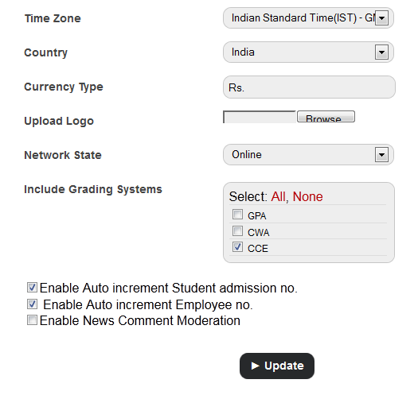
Step-1 First of all, go to general settings and choose CCE from drop down list of grading system

Slide 3
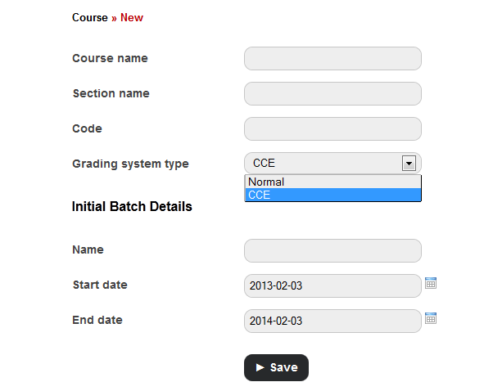
Step-2
Create a course and batches in that course.
While creating course, choose CCE from dropdown list.
Create subjects in the batch.

Slide 4
Step-3
Now, go to examination module and click to settings.
Click to set grading levels.
Click on add grades.
Add grades.
These grades are later used for FA and SA in scholastic in report cards.
Note: These grades are only for scholastic areas. For co-scholastic grades, we later set cce grades.
Its Snapshot is provided on next slide.

Slide 5
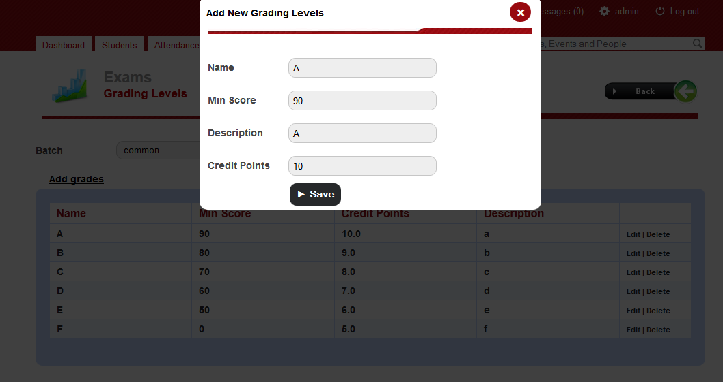
Adding Grades

Slide 6
Step-4
Now, Follow the path→
There are 4 options-
CCE grading sets
CCE exam categories
CCE weightages
Assign weightages
We will follow these 4 options step by step.
Examination
setting
CCE setting
Basic setting

Slide 7
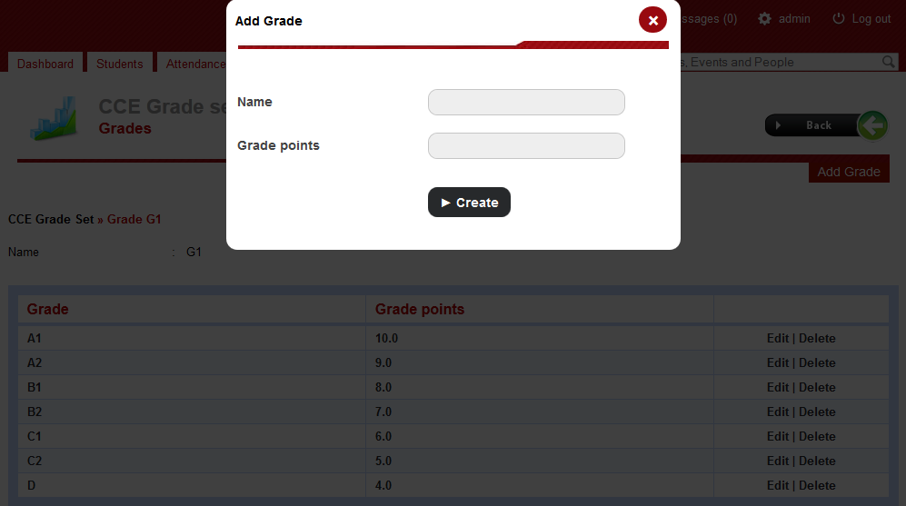
Create grade sets. Create grades with credit points in this grade set. Note: These grade sets will later assigned to co-scholastic area not to scholastic activities.
STEP-4.1
CCE Grading sets

Slide 8
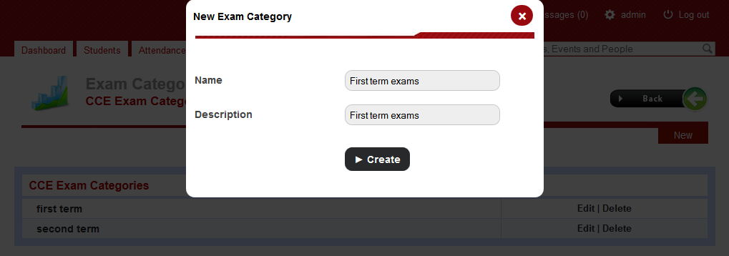
STEP-4.2 CCE exam categories
Create exam categories.
Example- first term exams and second term exams.

Slide 9
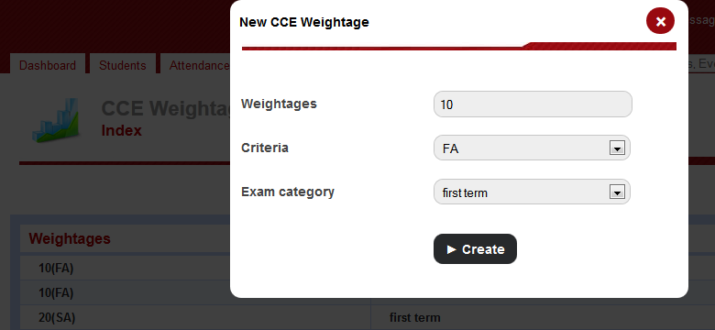
STEP-4.3 CCE weightages
Here we create weightages for scholastic areas and associate them with particular exam category. Example- FA with weightage 10 or SA with weightage 30.
These weightages will later assigned to different courses.

Slide 10
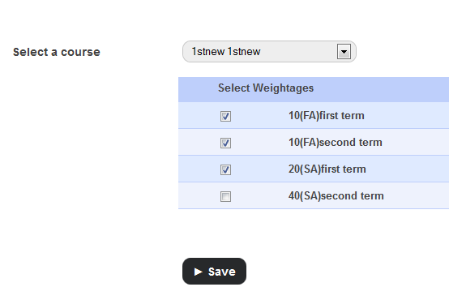
STEP-4.4 Assign weightages
Here choose a course and assign weightages to that course.
NOTE: you cant choose 2 FA or 2 SA of same exam category in one course .
Example: if you want weightages FA1(10), FA2(10), SA1(30) for a course, then simply assign FA(10) and SA(30) to that course.

Slide 11
Step-5
Create exam for this course. Follow the path→
Examinations
Exam management
Select course
Select batch
Click new

Slide 12
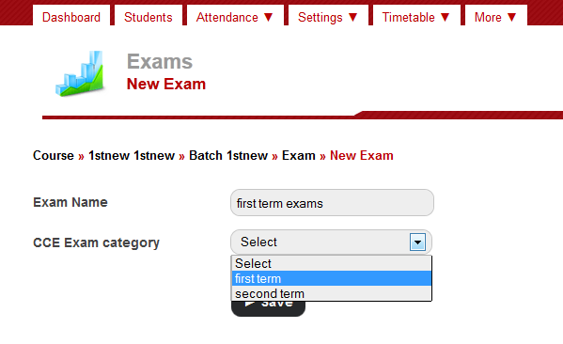
While creating exam, choose CCE exam category.

Slide 13
Follow the above path. Go to Co-Scholastic settings, here 2 options are there- Co-Scholastic items- Define co-scholastic items (activities and areas). Assign Co-scholastic items- Assign co-scholastic items to a course.
STEP-6
Examination
setting
CCE setting
Co-Scholastic settings

Slide 14
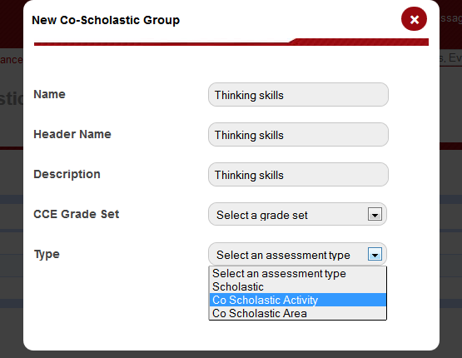
Here create observation groups and specify whether it is a Co-scholastic activities or areas.
STEP-6.1
Co-Scholastic items.

Slide 15
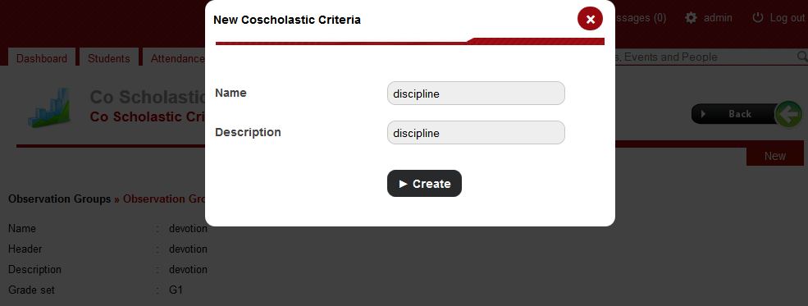
STEP-6.2
Now click on a observation group that you have created in previous step.
And create observations for this observation group.

Slide 16
STEP-6.3
Click on observation that you have created in previous step. And create descriptive indicator for this observation. Note : Later, Grades will be assigned to these descriptive indicators only.

Slide 17
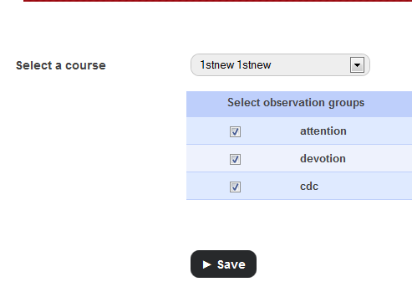
Step-6.4
Now Go to Assign Co-scholastic items.
Here, choose a course to which you want to assign Co-scholastic activities and areas.

Slide 18
STEP-7
Examination
setting
CCE setting
Scholastic settings
Follow the above path.
Go to Scholastic settings, here 2 options are there-
Formative assessment items- Define FA groups.
Assign FA items- Assign different FA groups to the subjects of different courses.

Slide 19
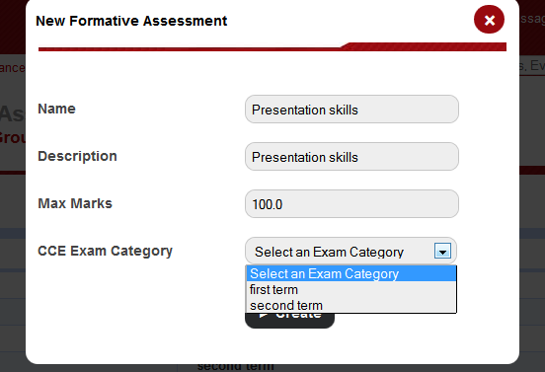
STEP-7.1 Formative assessment items.
Create FA groups in different exam categories.

Slide 20
STEP-7.2
Now click on a FA group that you have created in previous step.
And create FA criteria for this FA group.
Click on FA criteria that you created in previous step.
And create descriptive indicator for this FA criteria
Note : Later, Grades will be assigned to these descriptive indicators only.

Slide 21
STEP-7.3
Now Go to Assign FA items.
Here, choose a course to which you want to assign FA groups.
Choose respective subject from this course.
Assign FA groups to this subject.
Note: You cant assign more than two FA groups of same exam category to one subject.
This is because, there can be only two FA (FA1, FA2) in one exam.

Slide 22
STEP-8 Entering Result
Now, its time to the enter result of exams.
Follow path→
Examination
Exam management
Choose course
Choose batch

Slide 23
STEP-8.1 Entering SA scores
Click on exam in which you want to enter the marks and grades.
Click on subject.
Enter the marks of that subject.
Grades will automatically evaluated according to grades set in grading levels.

Slide 24
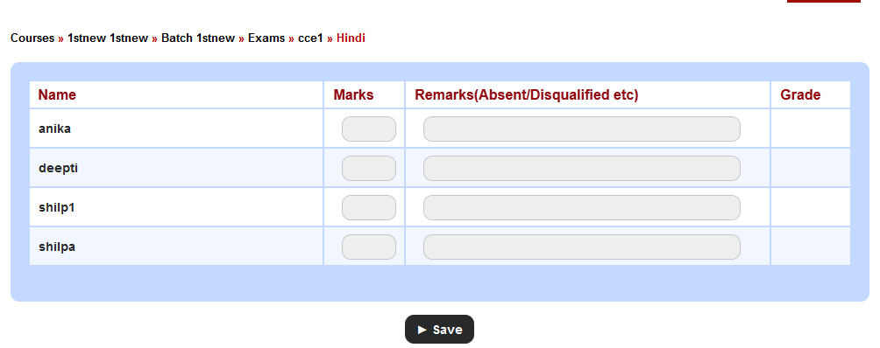
SNAPSHOT OF ENTERING SA SCORES

Slide 25
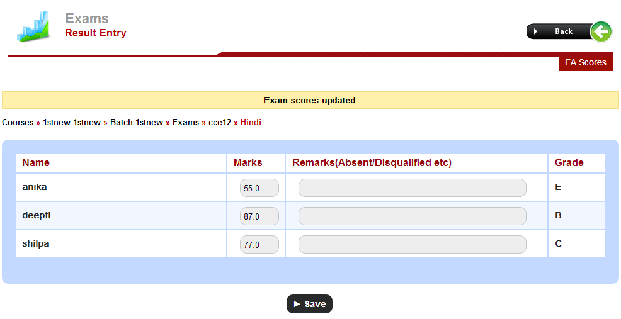
STEP-8.2 Entering FA scores
Enter the FA grades by clicking on FA scores.

Slide 26
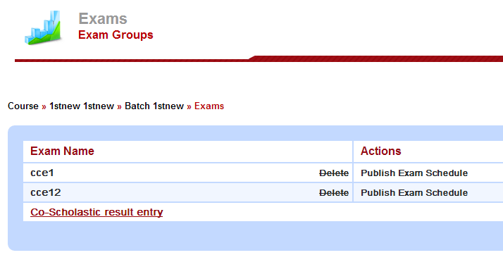
STEP-8.3 Entering Co-scholastic scores
Click on Co-scholastic result entry.

Slide 27
Step-9 Generating Report
Go to examination in the upper tab.
Click on cce report.

Slide 28
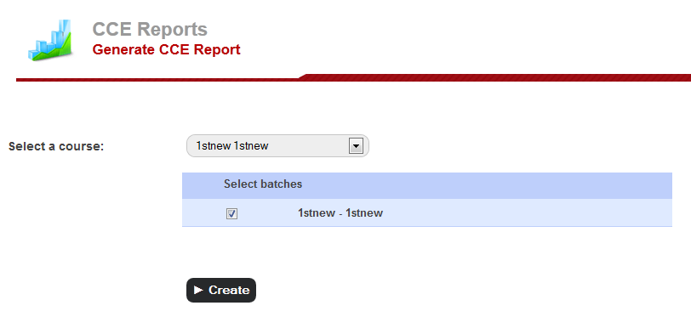
STEP-9.1 Generate Report
Click to generate reports.
Choose course.
Choose batch.
Click create.

Slide 29
Step-9.2 View Report
Click on view students report.
Select batch and report card be displayed on screen with automatically calculated CGPA.

Slide 30
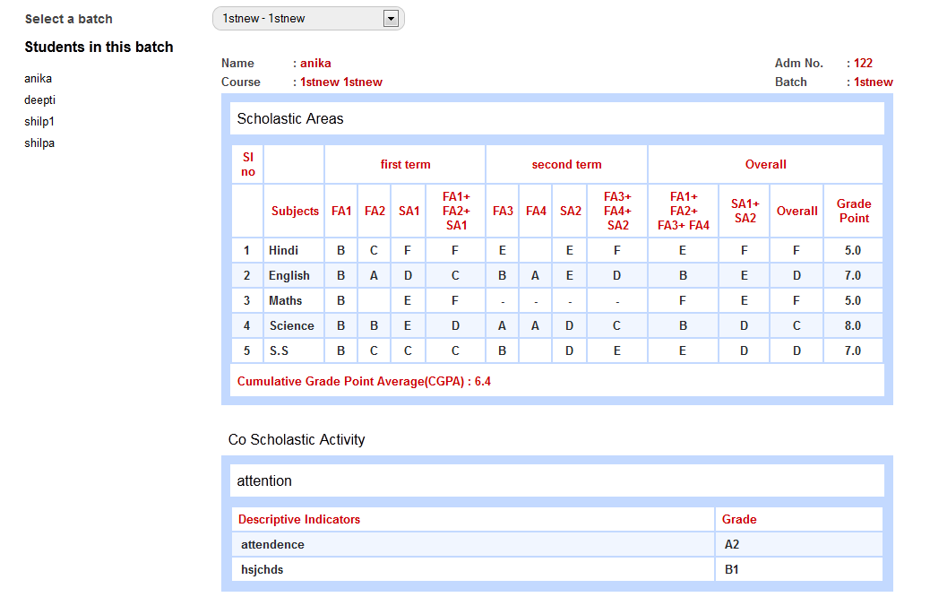
SNAPSHOT OF RESULT

