Slide 1



enterprise Software Solutions Lab Pvt. Ltd.
Mobile App
www.ampletrails.com
IP CAMERAS

Slide 2

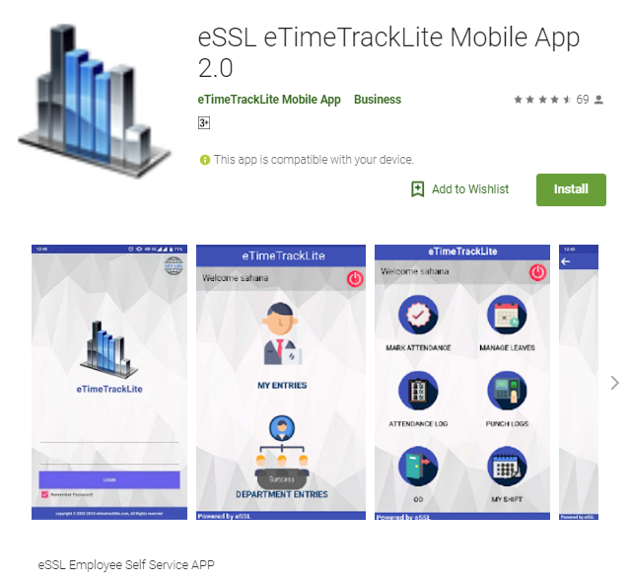
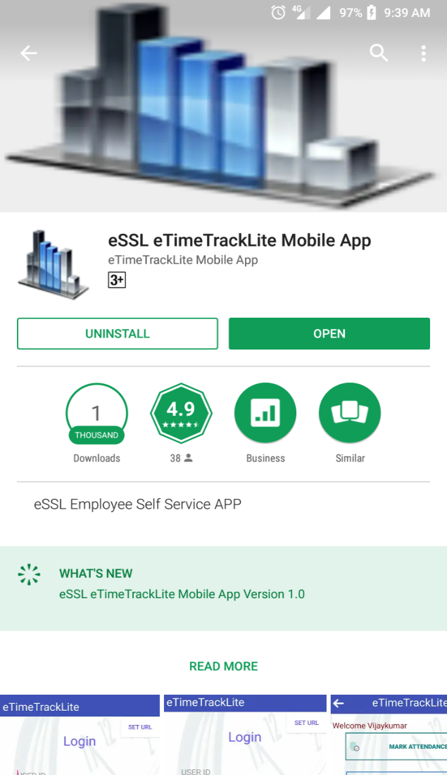
Employee self service Android App
www.ampletrails.com

Slide 3
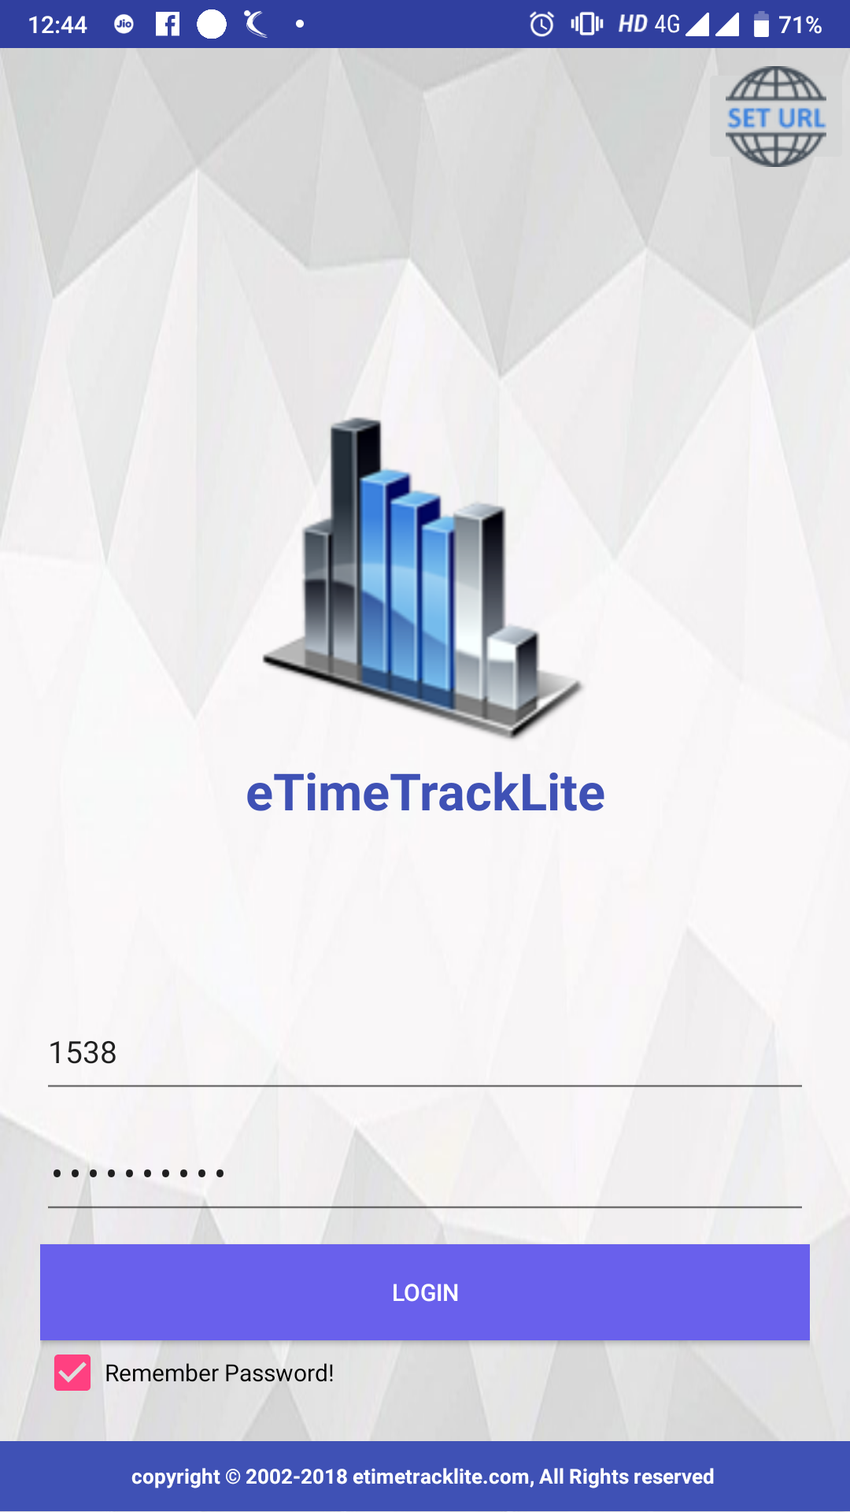
Main Page
Set URL: 111.126.79.105:85
Login Name
Login Password
www.ampletrails.com

Slide 4
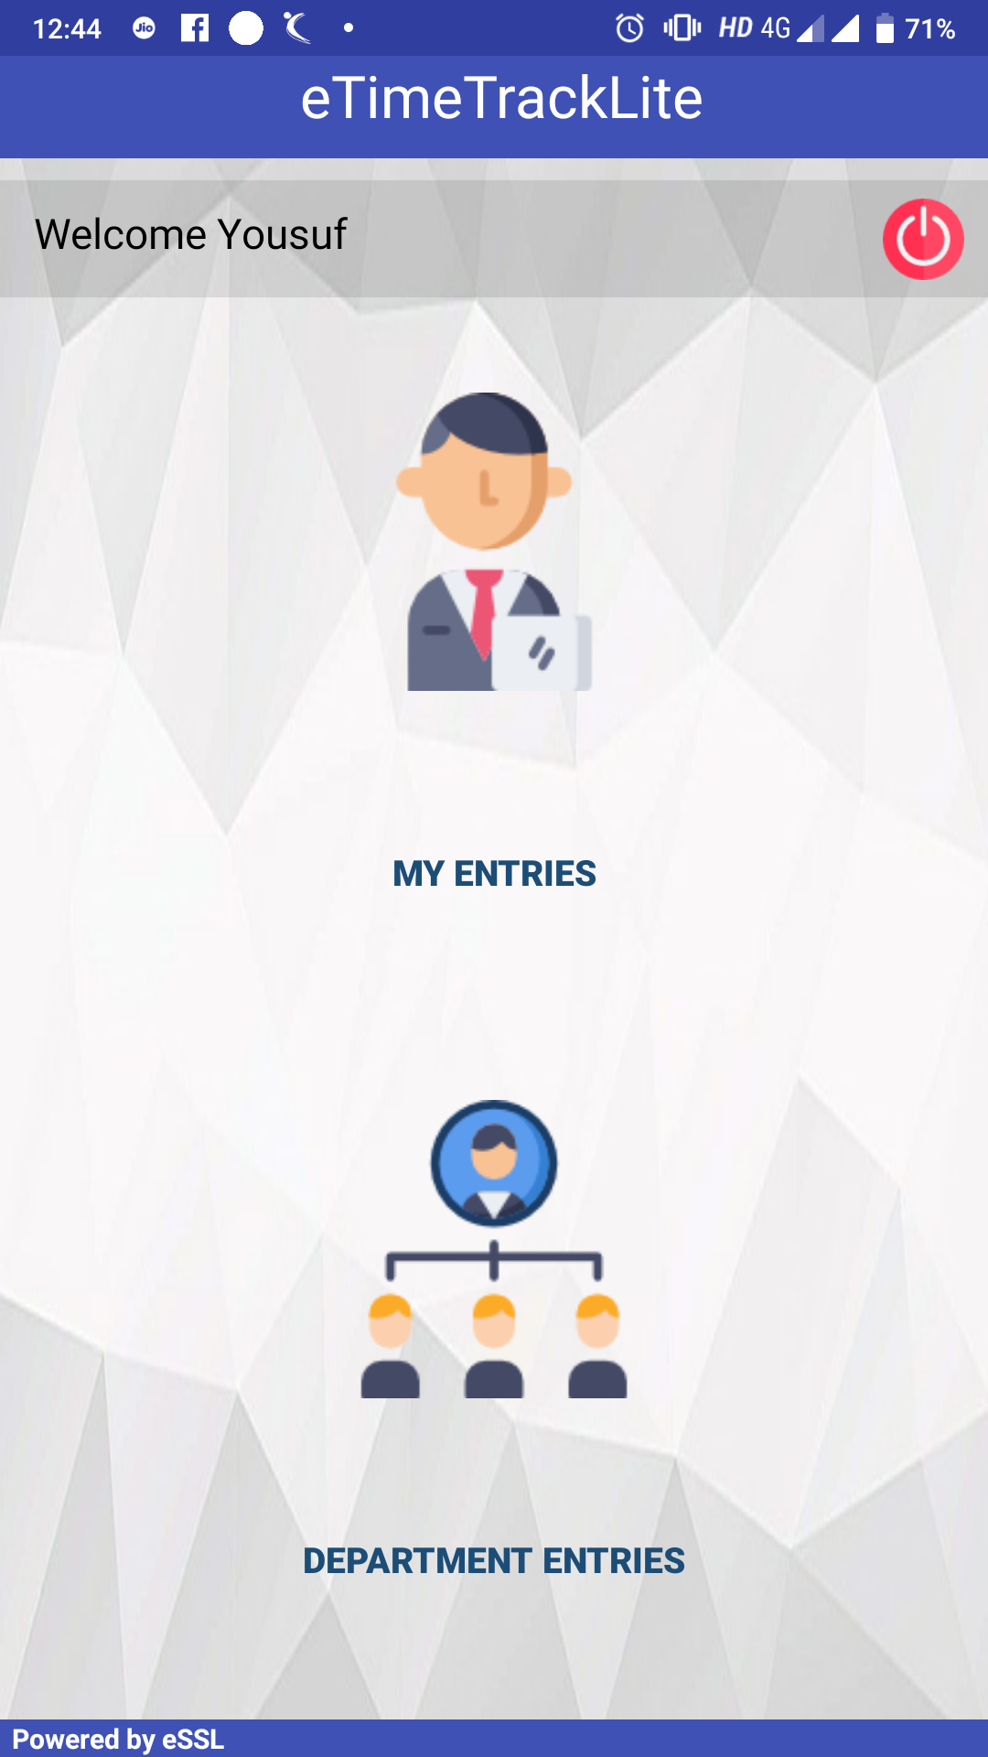
Department Welcome Page
www.ampletrails.com

Slide 5
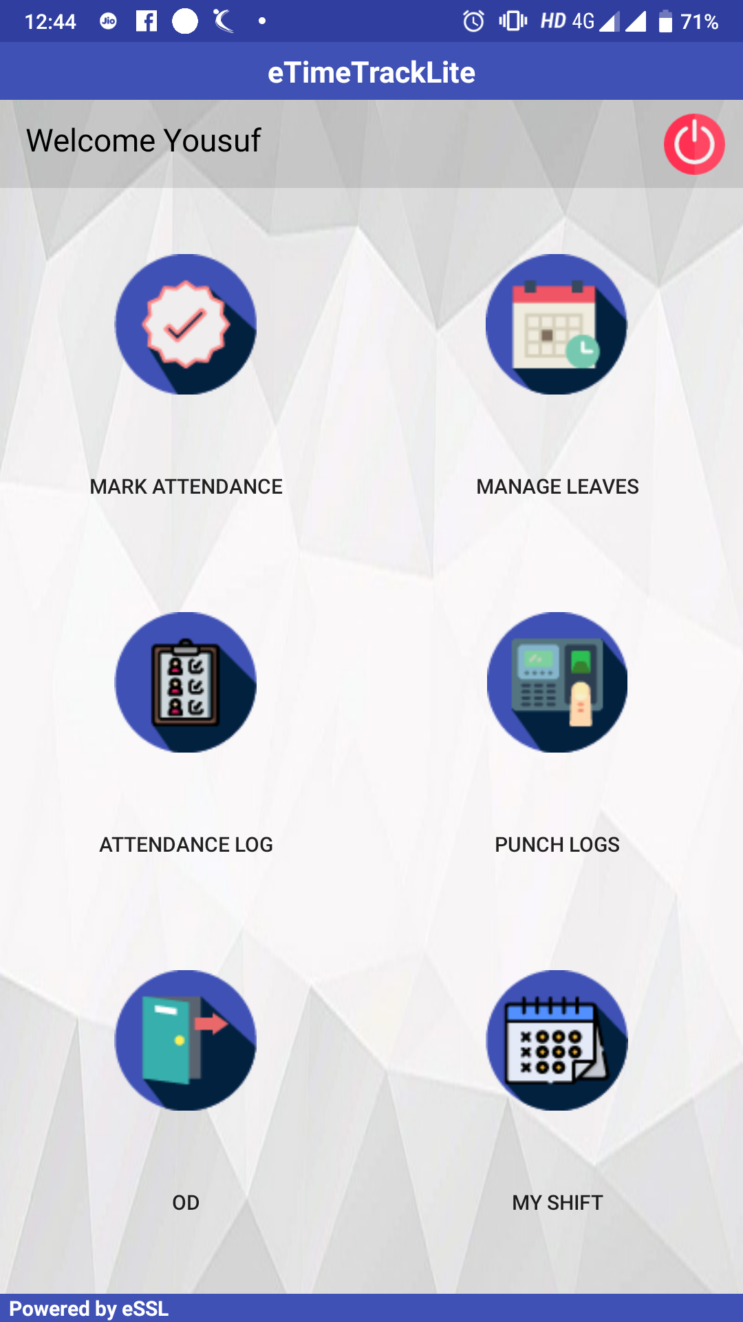
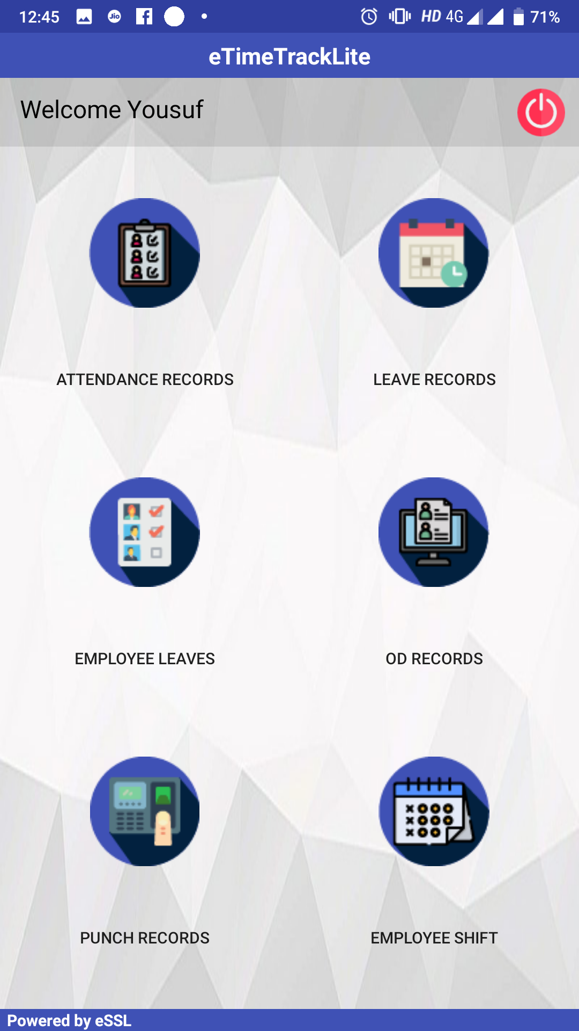
Employee self service Android App
Employee Login
Manager Login
www.ampletrails.com

Slide 6
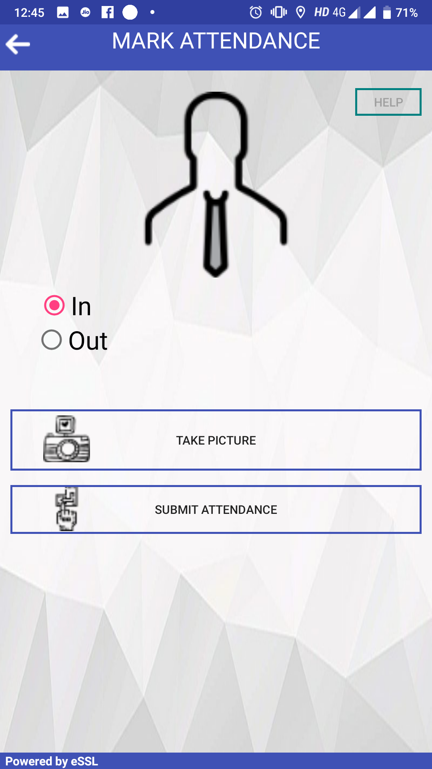
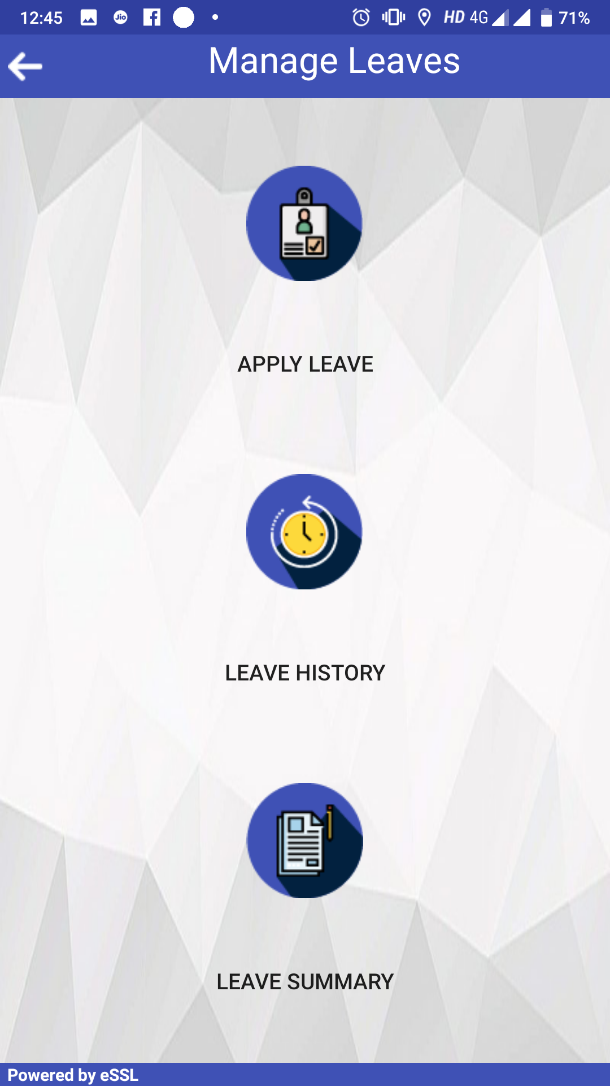
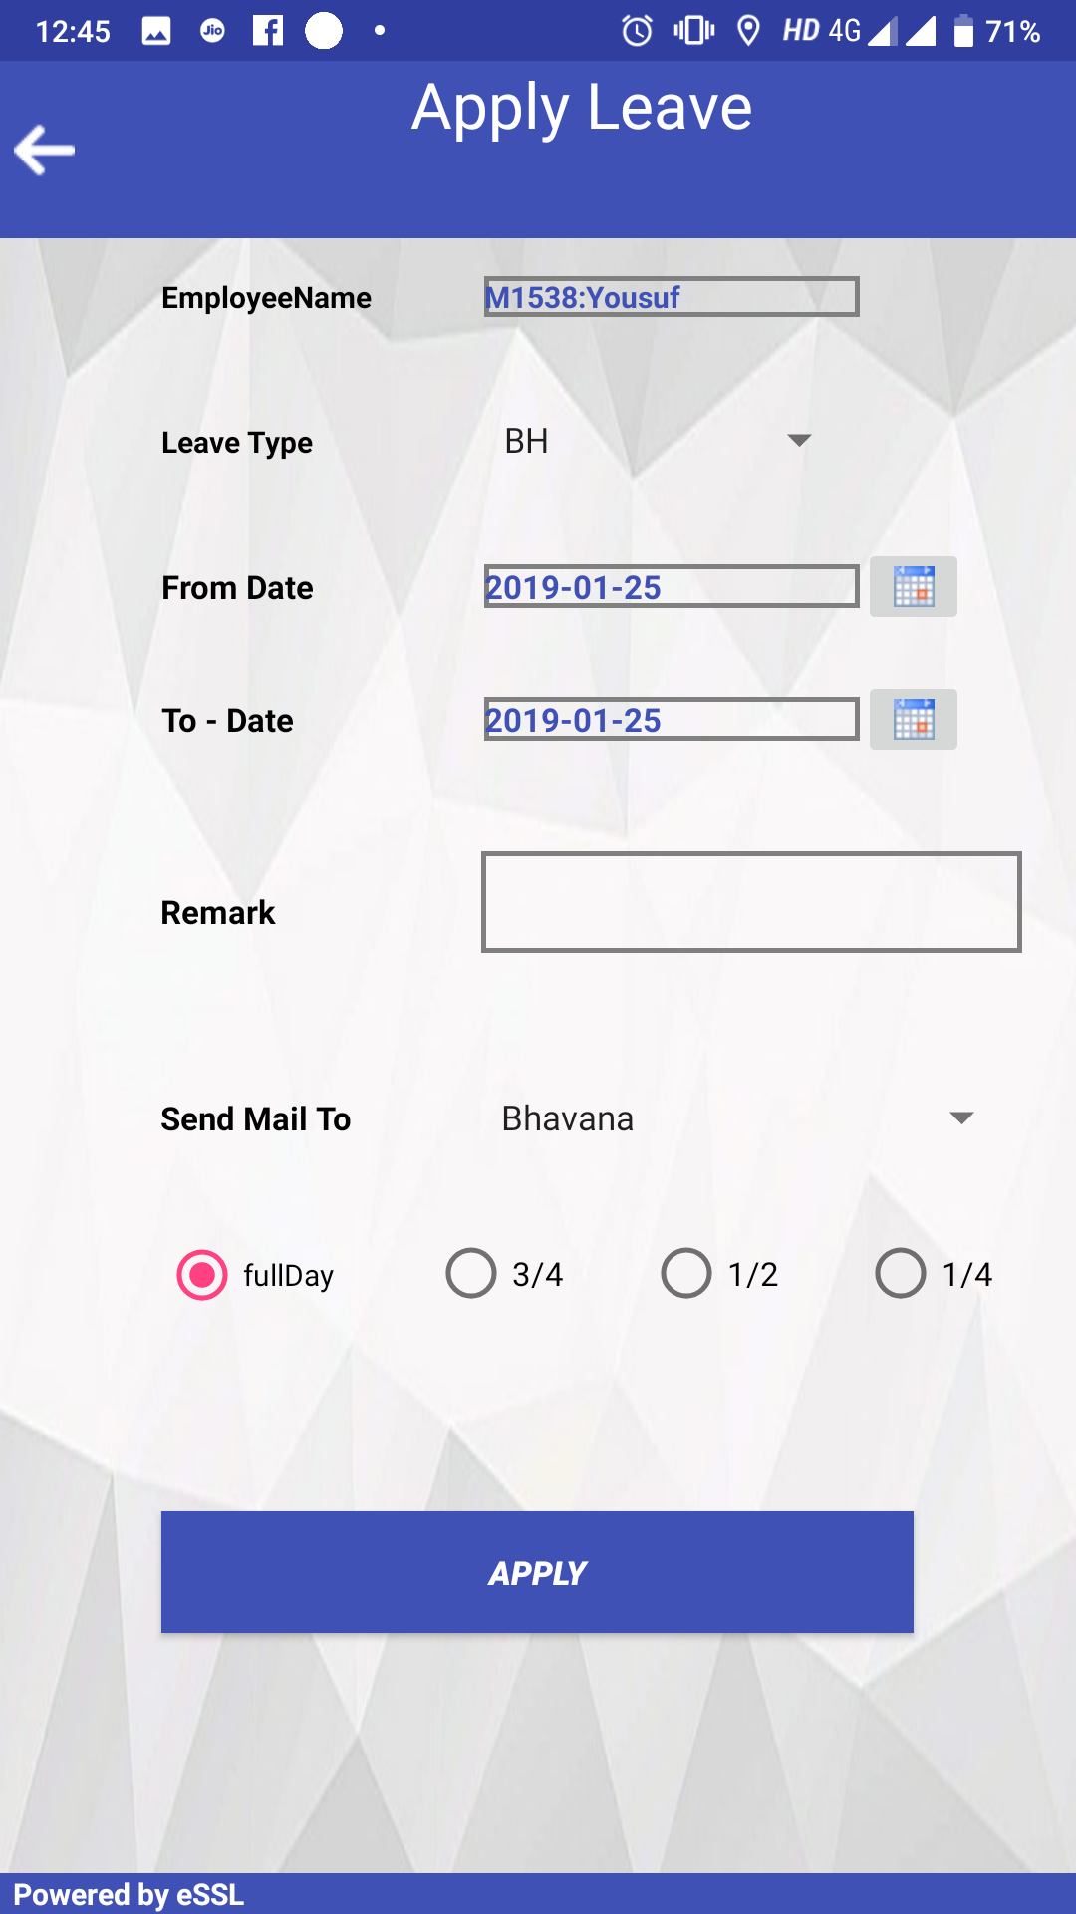
Employee self service Android App
Mark Attendance
Manage Leaves
Apply Leave
www.ampletrails.com

Slide 7
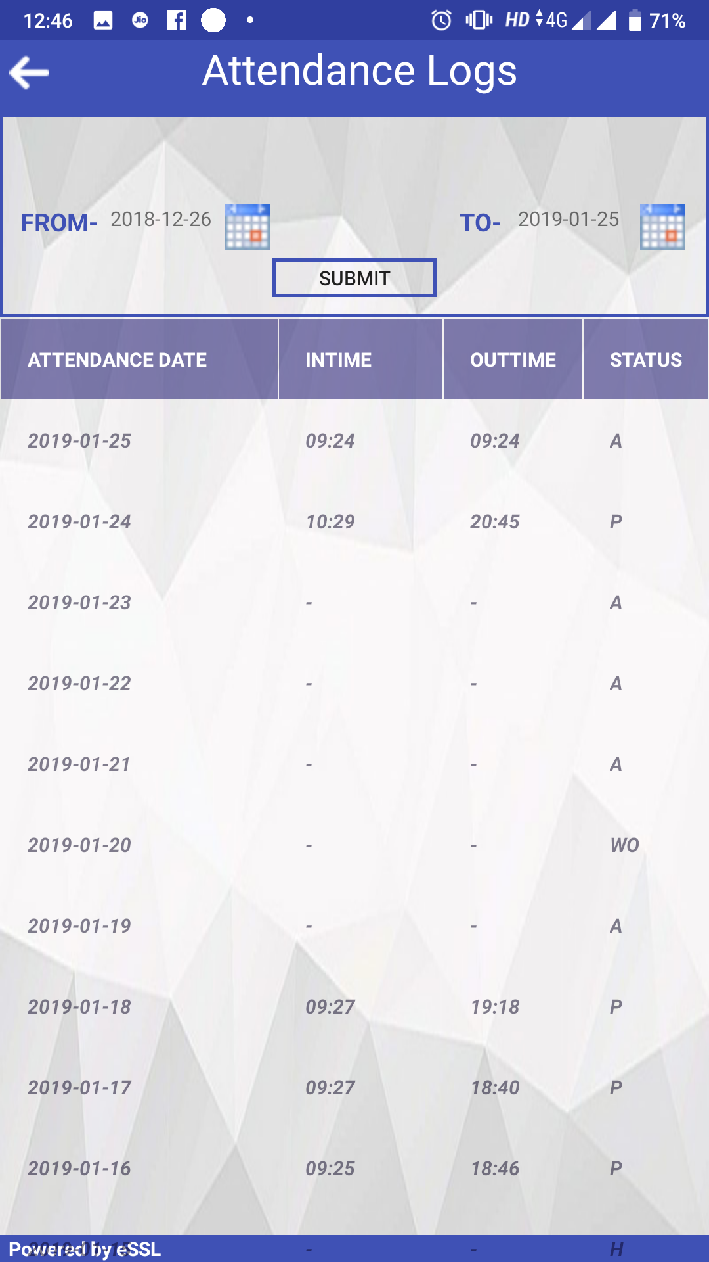
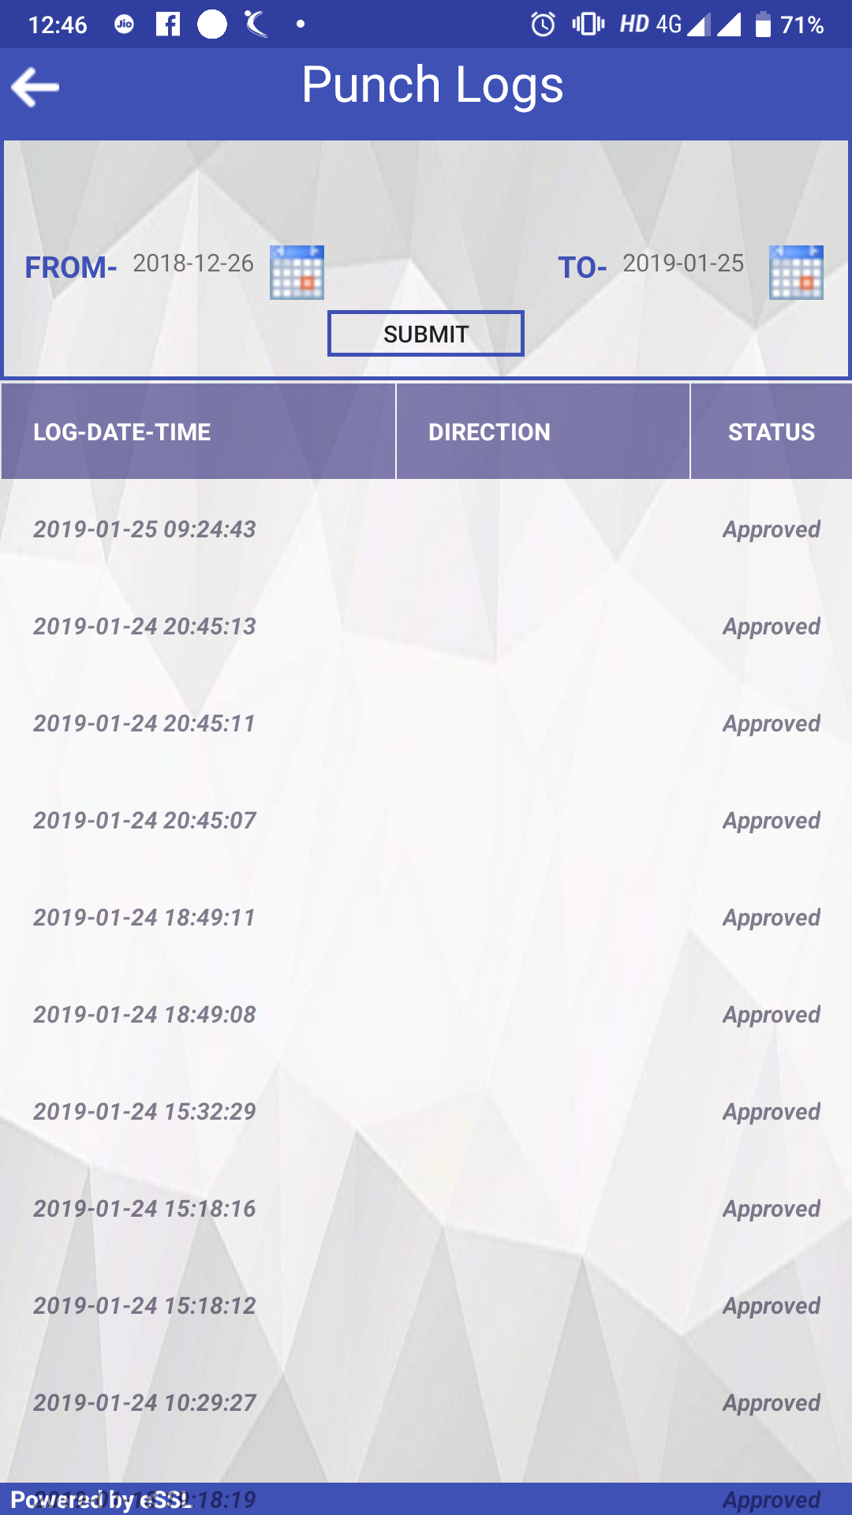
Employee self service Android App
Attendance Logs
Punch Logs
www.ampletrails.com

Slide 8

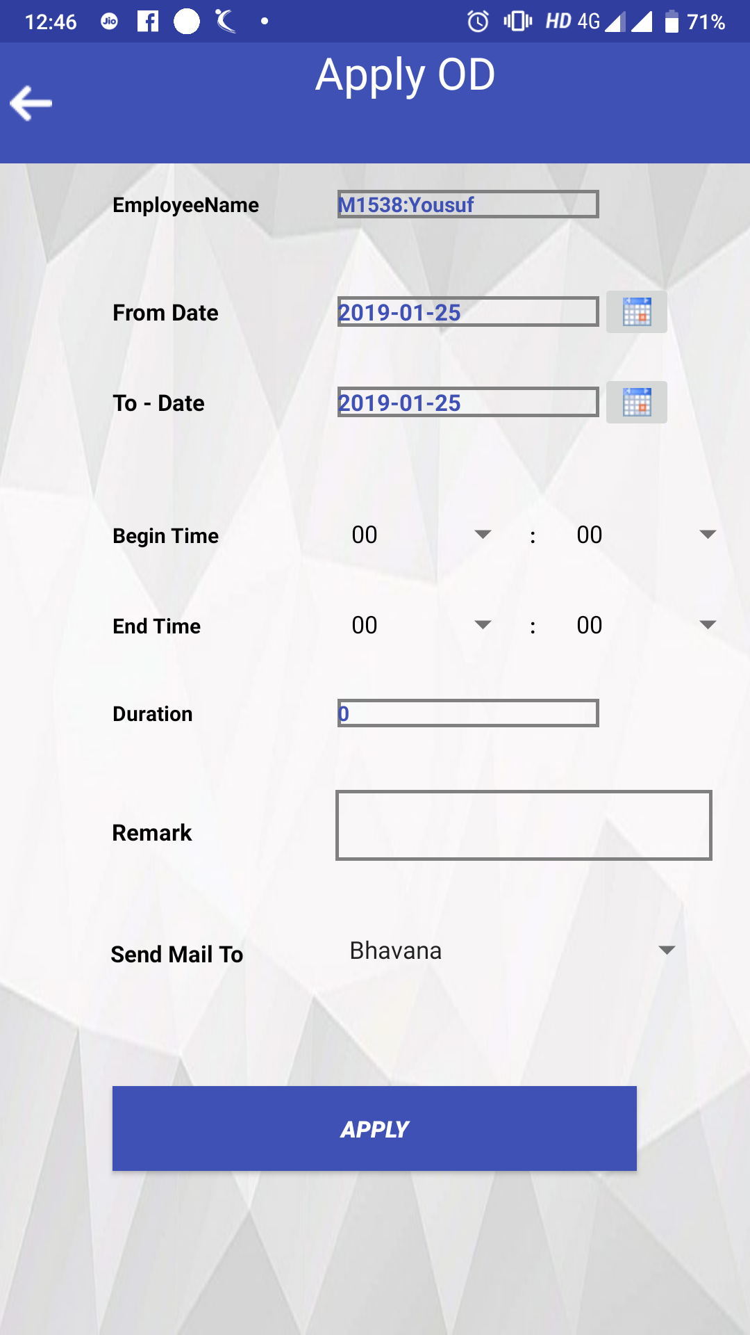
Employee self service Android App
Manage OD
Apply OD
www.ampletrails.com

Slide 9
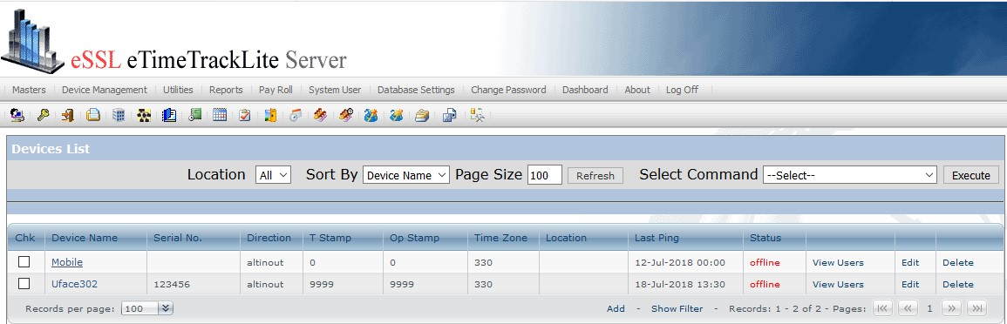
View Mark Attendance in eTimeTrackLite Application
Click Mobile Option
www.ampletrails.com

Slide 10
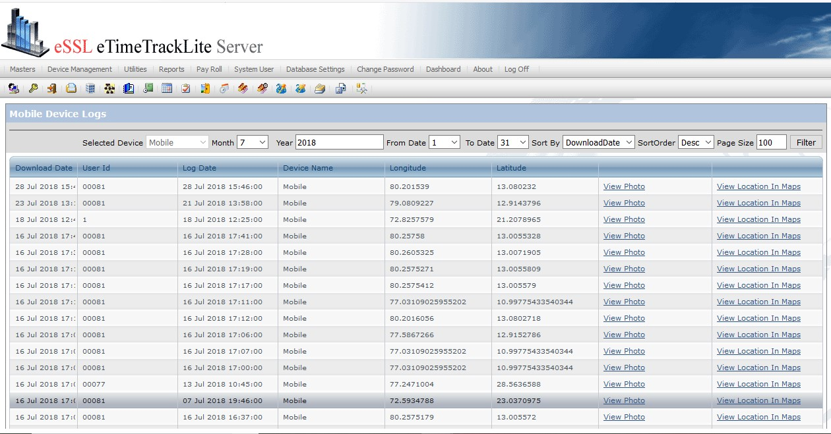

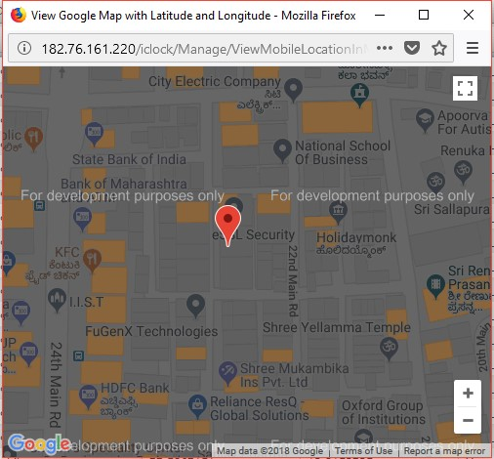
View Mark Attendance Photo and Location Map
www.ampletrails.com

