Slide 1


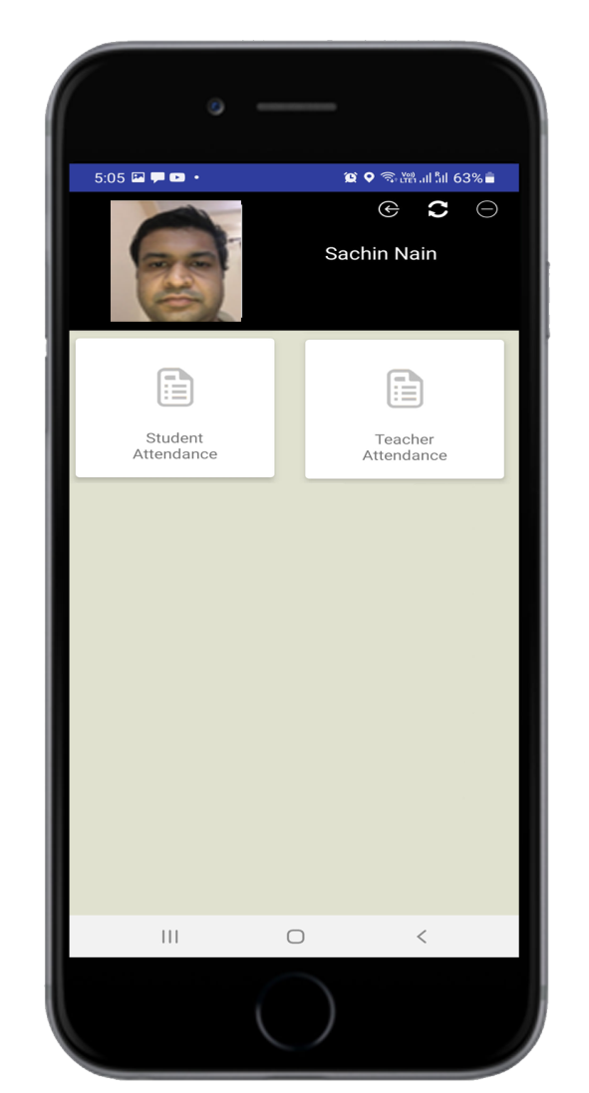
Smart
Attendance
System
Powered By Artificial Intelligence
www.ampletrails.com

Slide 2
About AmpleTrails
AmpleTrails is a Software based company which provides custom software to satisfy all your software needs. We create Web, Desktop, Android and iOS based applications using C#, MVC, Java, Swift and many other supporting languages. We also provide solutions for window services which can work automatically and perform the assigned tasks to them without any human efforts. Feel free to discuss your requirements with us and we can provide the best solution to you.
We also provide solutions for your hardware related requirements like biometric devices, Access control, Computers, printers and many more...

Slide 3
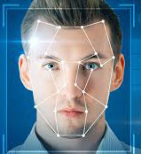
About App
Smart Attendance System
An Artificial Intelligence based mobile app which compares the face of Student/Teacher with the official records and only allow to mark attendance when the face is matched with the official records and Student/Teacher is standing in the geo radius of Campus. It also provides features to mark colleague attendance...

Slide 4


Available On

Slide 5

Add Class
Add Section
Add Teacher
Add Student
Add Lecture
Add Time Table
Relate Teacher & Lecture

Slide 6
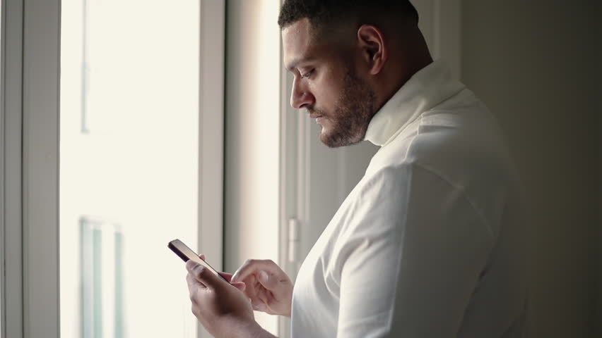
Face Attendance (Teacher)
The teacher will select the class and lecture and He/She needs to mark Face attendance with the Location compare option.

Slide 7
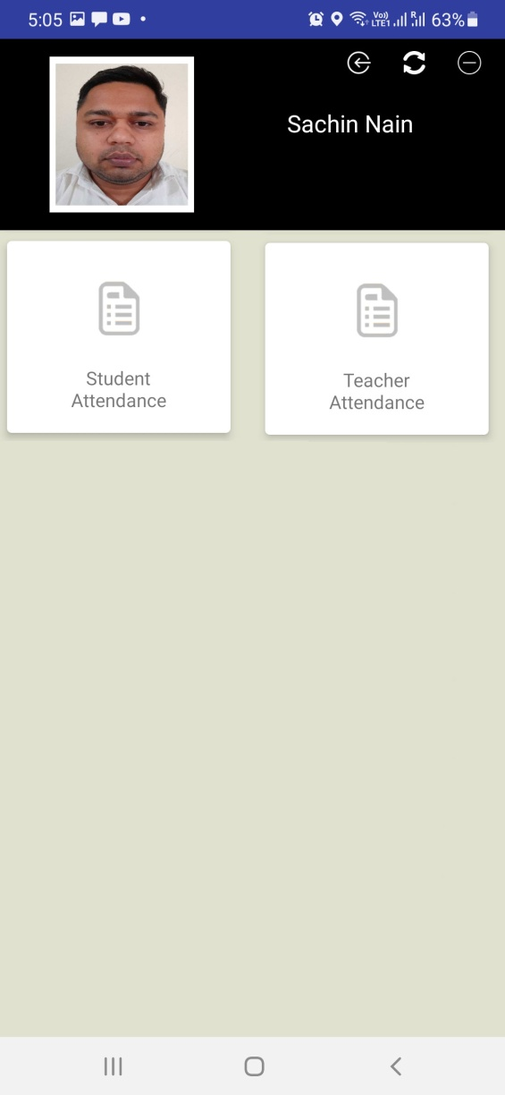
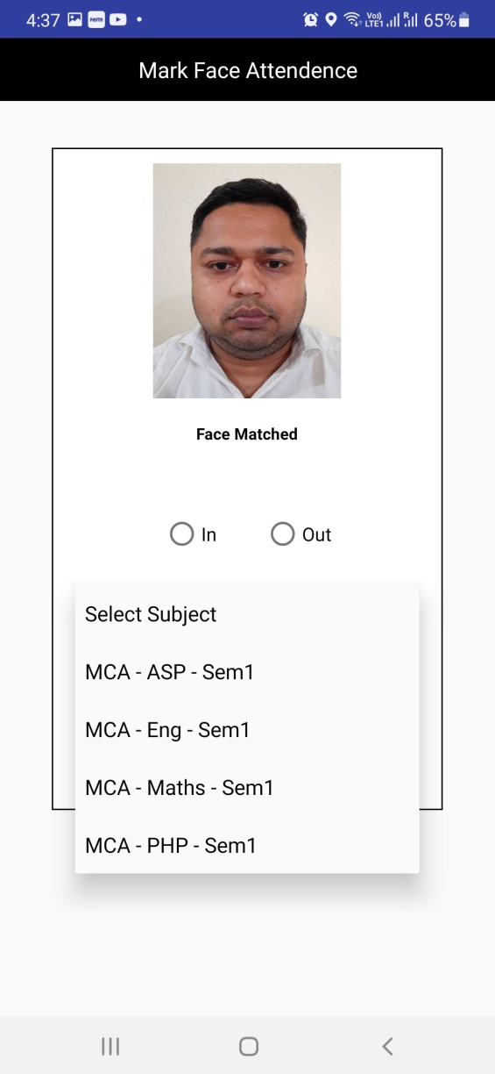
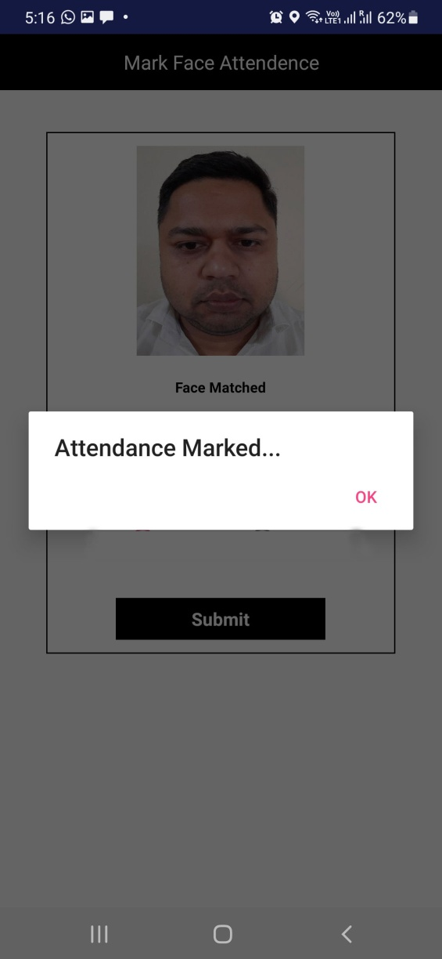

Teacher Attendance > Select Lecture > Save Attendance

Slide 8
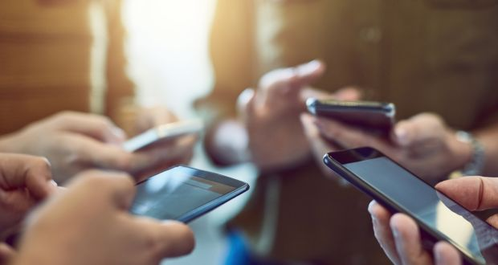
Face Attendance (Student)
Students will select the lecture and will be allowed to mark attendance if the Teacher has already marked the in attendance in that lecture and the Face and Location of the student will be also compared.

Slide 9
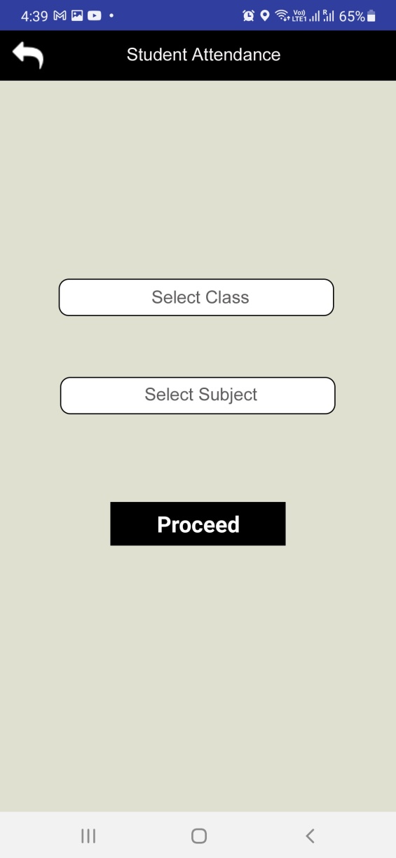
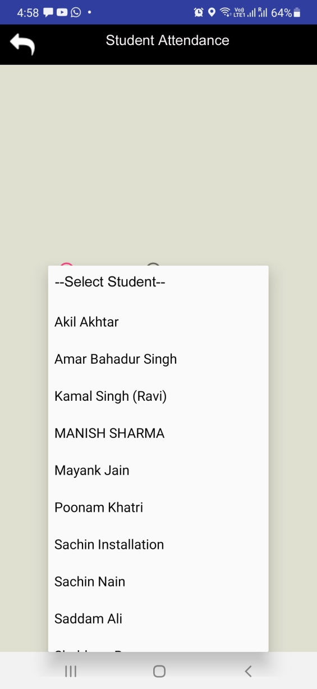

Student Attendance > Select Class & Subject > Select Student > Match Face > Save Attendance

Slide 10
Auto Alerts
Get Daily Attendance Logs Automatically On Email
01
02
Get Daily Absent Students Automatically On Email
Get Daily Leaves Record Automatically On Email
03
Details of Leave Applied by Students are Instantly Sent on Mail
04

Slide 11
You can get reports based on time table whether the student was available in the lecture or not and all the attendance logs marked by student.
Easy Reports

Slide 12
Global Supply
India
Content here
We are from India but can supply across the Globe…
Get a modern PowerPoint Presentation that is beautifully designed..
Call 9315441053/78

Slide 13

THANK YOU

