Slide 1
Integrated Library Management System
KOHA

Slide 2
What is koha
Koha is integrated library management system developed by Horowhenua Library Trust and Katipo Communications Ltd, New Zealand.
It is designed to manage physical collections of items (books, CD's, videos, reference, etc.)
Koha is web-based ILS, with a SQL database backend with cataloguing data stored in MARC and accessible via Z39.50. The user interface is very configurable and adaptable and has been translated into many languages.

Slide 3
It provides cataloguing, Searching, Member / patron management, an acquisitions system, and circulation (issues, returns, and reserves).
Circulation is handled with a full screen curses interface or a Web-based interface. It has OPAC and cataloguing, acquisition circulation modules.

Slide 4
Koha Feature
A full featured modern integrated library system (ILS).
Linux, Unix, Windows and MacOS platform.
Web Based. We can full integrate it into your website.
Full MARC21 and UNIMARC support for professional cataloguing.
Use as a document manager or digital library.
Manage online and off line resources with the same tool.
E-mail and/or txt patron's over dues massage and other notices.

Slide 5
Print your own barcodes.
Full catalog, circulation and acquisitions system for library stock management.
Web based OPAC system (allows the public to search the catalog in the library and at home).
Simple, clear search interface for all users
Multilingual and multi-user support
Export and import records, ISO2709

Slide 6
Who use of koha
More than 50000 libraries are using Koha, including academic, public, school and special libraries, in Africa, Australia,Canada, USA, France, India and, of course, New Zealand.

Slide 7
Koha System Architecture
Koha requires only a web browser on the workstation (a graphical browser, or even a text browser for the OPAC).
Koha thus functions on PCs running Windows , PCs running Linux, Macs, or even UNIX workstations. Koha is based on a client-server architecture.
Network Server: koha can be installed on a server running Linux, Unix, Mac. although Koha can run on any modern operating system.
Client Workstations
Koha runs over any TCP-IP network.

Slide 8
Modules of Koha
Cataloguing
Membership modules
Report generation
Circulation
OPAC
Acquisitions
serials

Slide 9
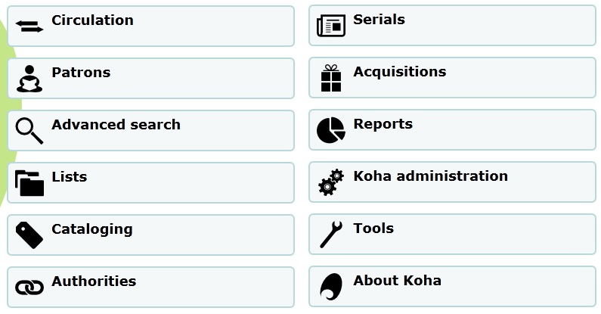

Slide 10
Cataloguing
The cataloguing module is one of the principal strong points of Koha. Several "frameworks " can be defined to do different cataloguing for monographs, electronic resources, periodicals.
Copy records:-One or more copy records can be attached to each bibliographic record.
Searching:-searches can be performed on any MARC field. Advanced functions, search on one word, the beginning of the field.

Slide 11
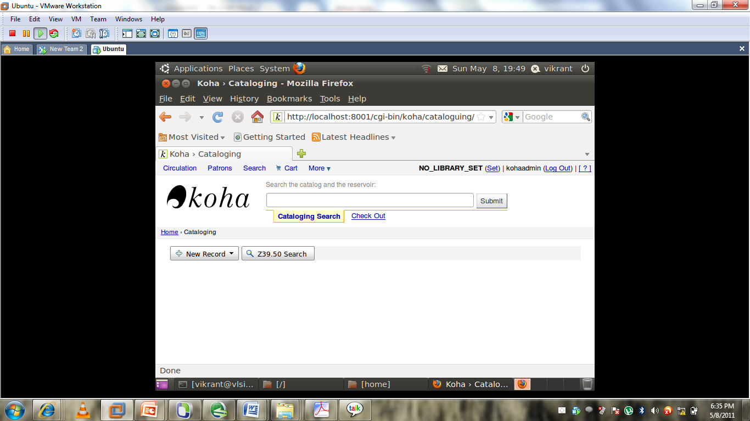

Slide 12
Membership
The member module of koha maintain member‘s record containing detail such as name, address, telephone, fax, email membership number, card number Card Category, Address, OD/Issues, Fines notes,
Add New Members :- Using this function a new member can be added. We can add adult or institution by using this option.

Slide 13
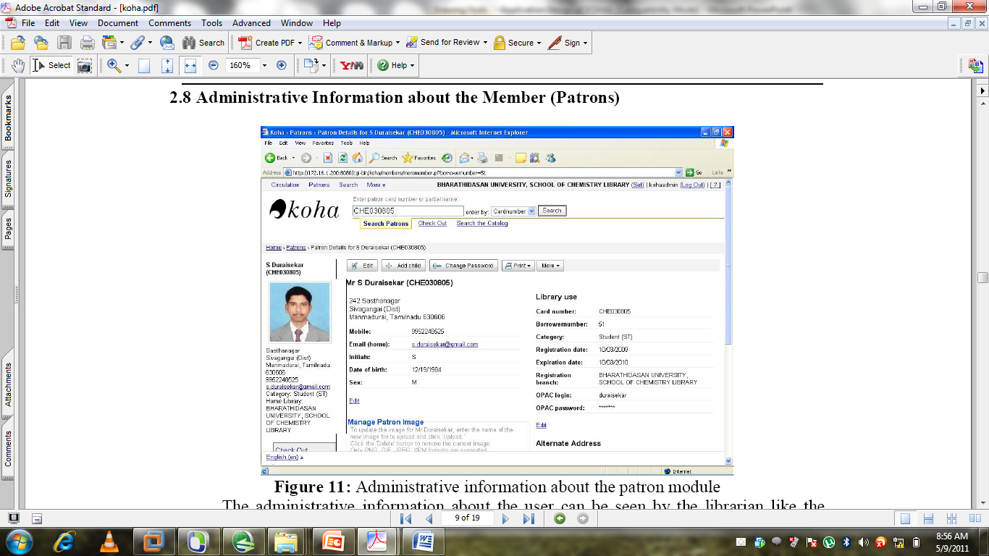

Slide 14
Report Genration
Report module is very important feature in koha.
Report is used to find the information about
Patrons, cataloguing &most circulate item.

Slide 15
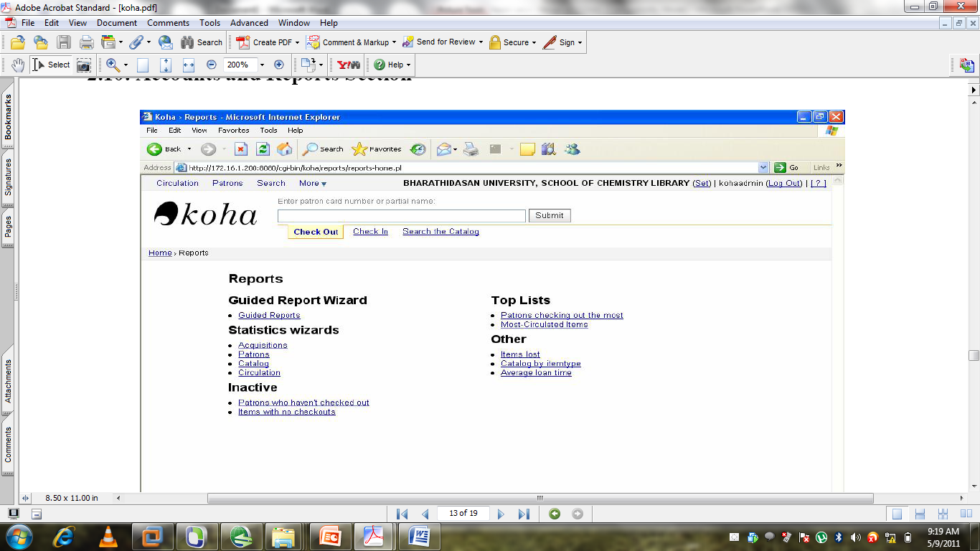

Slide 16
Koha Circulation
The circulation system maintains up to date membership record and the latest status of the collection meant for circulation.
Checkout :- While issuing a book the respective user‘s last name or member card number is keyed in the place provided in circulation section. This takes to the issuing form which includes the item number box

Slide 17
Check In: Check in of the book is known as Returns in Koha, if any issued book is returned on or after due date, the item number is keyed in, which provides the details about the book as well as the member information.
Overdue Notice: The over due notice are generated by having any document monograph, journals or documents on lone under ILL that maintain directly to members optionally, along with overdue titles may generated for the record of the library staff.

Slide 18
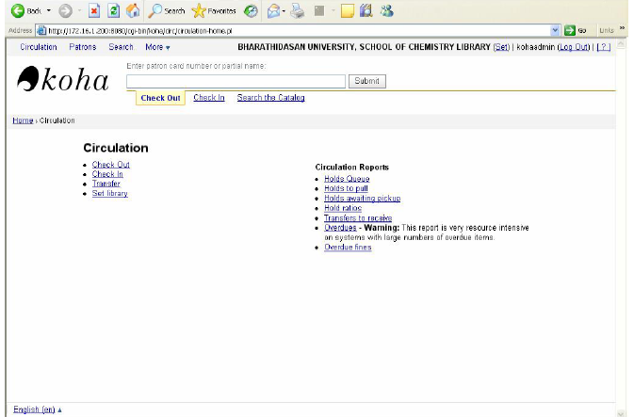

Slide 19
Opac
Koha provides a full-functioned Online Public Access Catalog (OPAC).
OPAC users can carry out searches starting from ten fields (Keyword, Subject, Title, Class, Barcode, author, publisher, etc.). As in the librarian interface, they can order the results according to several criteria.
OPAC users who are logged-in members can place reservations on library items.

Slide 20
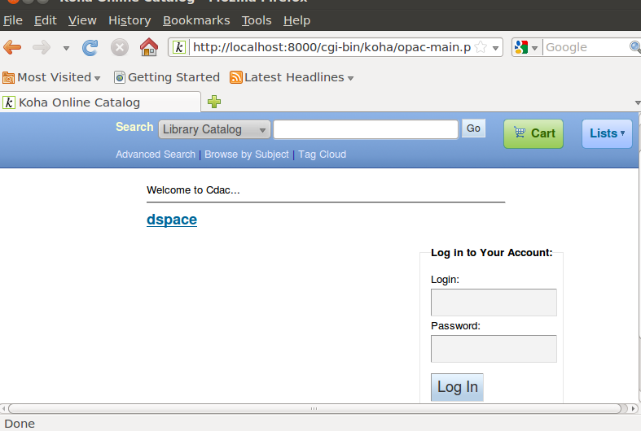

Slide 21
Koha acquisitions
Simple acquisitions:- Simple acquisitions module makes it possible to acquire materials and add them directly to the catalogue. It does not manage budgetary matters, the orders placed with the suppliers, etc.

Slide 22
Full Acquisitions: The full acquisitions module makes it possible to manage: Budgets and book funds: Budget available, Committed, Spent Suppliers. Orders, via 'shopping baskets.

Slide 23
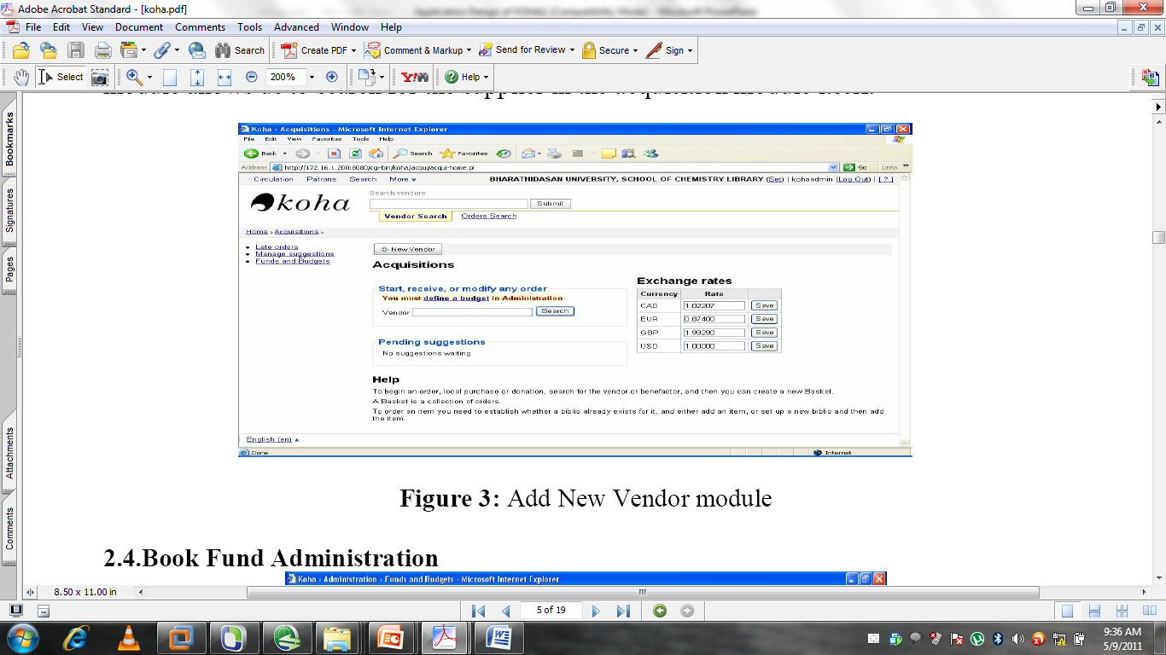

Slide 24
Koha Serials
Koha manages late issues, skipped issues, and claims with the suppliers.
Koha manages complex classifications, allowing the librarian to work with eleven different publication periods (from daily newspapers to annual publications), with delayed publications, and with publications out of sequence.

Slide 25
Thank You

