Slide 1

enterprise Software Solutions Lab Pvt Ltd
X990 – Fingerprint Time Attendance with Access Control terminal

Slide 2
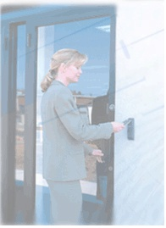
General Issues faced by Business Organizations
Attendance Proxy through “buddy punching”
Errors when computing time
Cost of paper time cards and manual records
Unauthorized overtime payments
In a recent study it was found that “Buddy Punching” inflates the payroll by 2.2% on an average.
Ex : If an organization is with 5000 employees and average salary of Rs.12,000 a month, the payroll inflation would be about Rs.13 lakhs only from buddy punching.

Slide 3
Biometric Attendance for Your Office
Biometric time systems eliminate buddy punching because they are inextricably linked to the employee, not to a token such as an employee badge or a time card.
No need for separate cards
Administrator can operate it, no need of contacting vendor again and again
Saves lot of time and cost of company by eliminating manual registers and cards etc.
Provides accurate and authenticated information

Slide 4
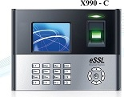
X990 Specifications
Storage capacity | Fingerprints templates Card Storage | 3,000 3,000
 | Transaction 1,00,000
 | Card reader | Yes
 | CPU | 800 MHz 32 bit Microprocessor
Biometric | Fingerprint sensor | 500 DPI Optical sensor(Optional Secugen STQC certified sensor)
 | FAR | <=0.0001%
 | FRR | <=1%
 | Identification speed | <1 sec
 | Algorithm Ver | 10
Audio/Visual | Display | 3 " Color TFT
 | Keypad LED Indicator | 4 x 4 with 5 function Keys
 |  | Green/Red
 | Schedule Bell/Speaker | Mini Speaker
Power & environment | Power Supply | DC 12V: 2Amp
 | Operating Temperature | 0ºC to 45ºC
 | Operating Humidity | 20% - 80%
 | Dimension | 210 x 157 x 40mm

Slide 5
X990 Specifications
Communication | Communication | TCP/IP, USB, ( Optional : Wifi, GPRS, GPRS+ GPS)
 | Push data | Inbuilt
 | Standard features | work code,SMS,DLST, Self service query, Status Switch
Access control | Wiegand | In & Out both 26 or 34 bit (With or without site code)
 | Relay | 12 V relay for lock EM lock, Bolt Lock or Strike lock
 | Support Fire Alarm | Yes
 | Door Sensor | Yes
 | Anti Passback | Yes
 | Door Bell | Yes

Slide 6
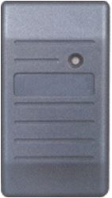
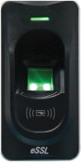

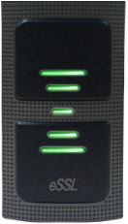
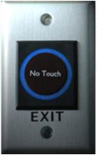
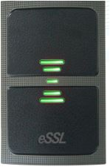
X990 Compatible Readers For Exit
FR1200 101HE Exit Switch
No Touch Exit KR500
Sensor
KR503

Slide 7



X990 Supporting Software
Software
Database
Smart office - Desktop
eTimeTrackLite -Desktop
Smart office - Web
eTimeTrackLite - Web
ePushServer - Web

Slide 8
THANK YOU
enterprise Software Solutions Lab Pvt Ltd

