Slide 1
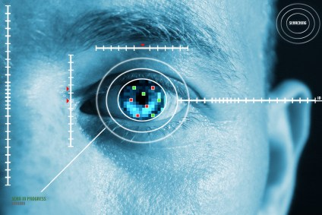
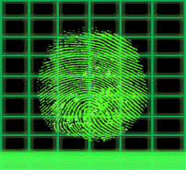
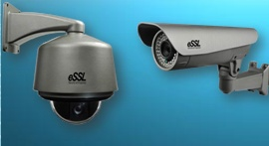
IP CAMERAS

Slide 2
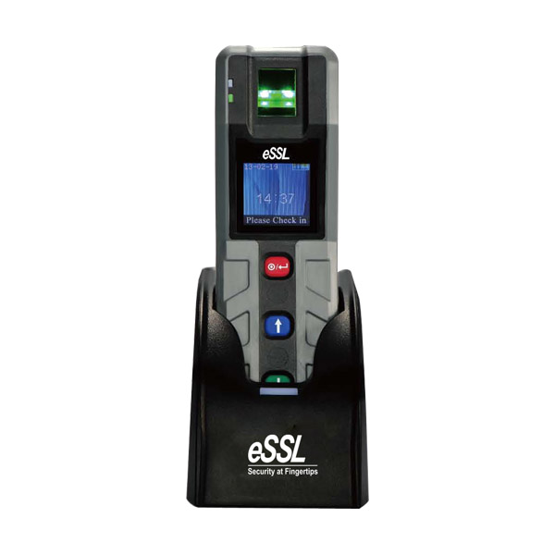
PT 100 Guard patrol system

Slide 3
Introduction
PT100 is a fingerprint guard patrol tour device it will store the time and attendance of Guard It is a management system designed for security, attendance, and logistics companies.
It helps ensure that the "right" employee makes his or her appointed rounds at the correct intervals and can offer a virtually indisputable record for legal or insurance concerns

Slide 4
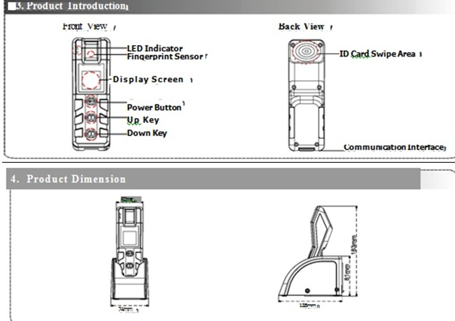
Picture demonstrating product parts and dimensions

Slide 5
Technical Specification of PT 100
Model | PT100
Fingerprint Capacity | 500
Card Capacity | 1,000
Log Capacity | 30,000
Fingerprint Sensor | Infrared Auto-sleep Optical Sensor
Fingerprint Algorithm ver | 10 Alg ver
Communication | USB Client
Built-in RF Card Reader | 125KHz Proximity Card(Optional 13.56MHz Mifare Card)
Power Suply | 5V, 800mA
Battery | 2,000mA Lithium Battery
Operating Temperature - | 10℃～40℃
Dimension(L*W*D) | 162*52*46mm
Net Weight | 0.22Kg
Ingression Protection Rate | IP65

Slide 6
Technical Features of PT 100
1.44” colour LCD display
Fingerprint authentication, accurate and convenient and effectively stop "buddy Punching"
Robust design for shock resistant, anti-drop up to 1m
IP65 rated waterproof and dustproof
Low Power Consumption, Standby 7 days,
Reads EM 125 KHz Proximity Card and Tags
Dedicated Patrol Software For System Configuration, Data Collection and making reports.

Slide 7
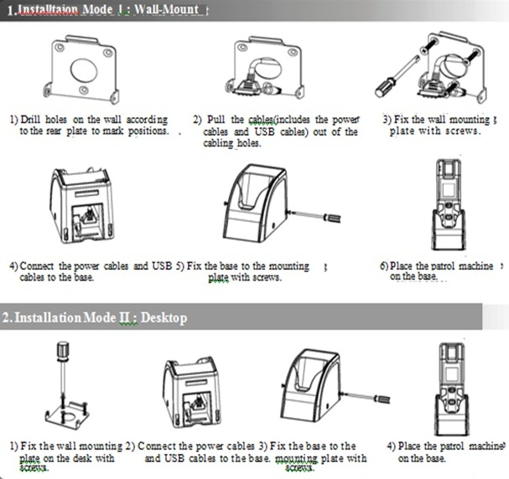
Picture describing the physical installation of PT 100

Slide 8
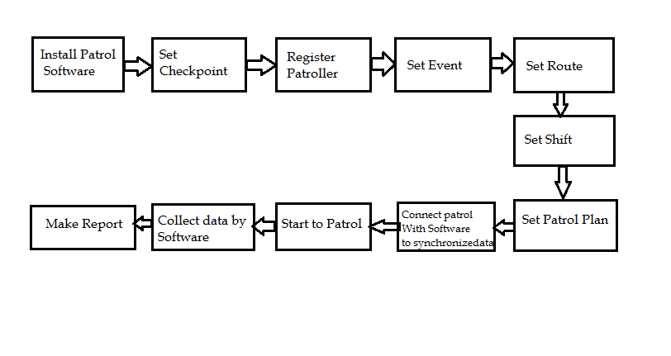
Patrol Workflow

Slide 9
Minimum system requirements for Patrol 1.0 Security System software installation
Configuration Requirements :-
CPU: 2.0GHZ Main Frequency above
Memory: 1 GB or above
Hardware: Available space of 10GB or above. And NTFS hard disk partition as the Software installation directory
Supported Operating Systems :Windows XP/ Windows 2003/ Windows 7
Supported Database: Microsoft Access/ Ms SQL Server 2005 and above Version.

Slide 10
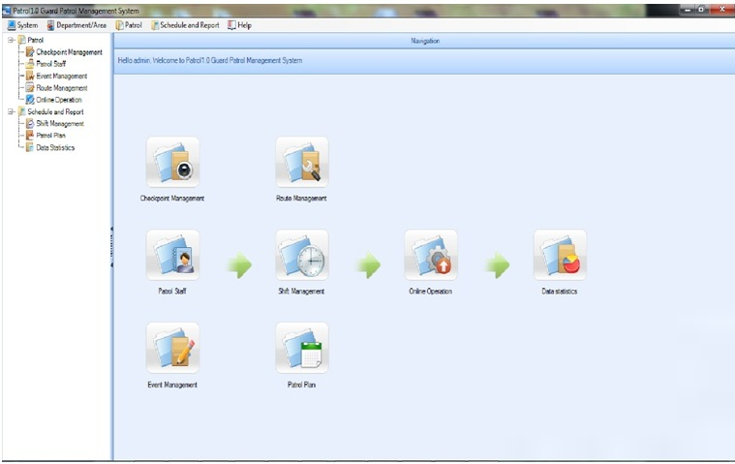
Flowchart of operations to be done in the software after installation.

Slide 11
Key features of the PT100 device
Fingerprint authentication, accurate and convenient.
Robust design for shock resistance and anti-drop up to 1 minute.
IP65 rated waterproof and dustproof.

Slide 12
Schematic diagram of connections of device to pc

Slide 13
For Your Time & Attention
Contact Us: 9315441053
Email id – info@ampletrails.com
Website: www.ampletrails.com

